Slide 1
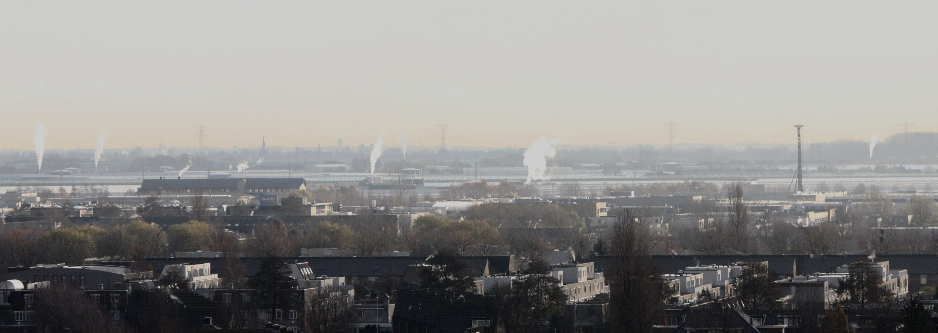


Subsurface resources in the Netherlands
. –the changing focus from fossil to geothermal energy- | Harmen Mijnlieff

Slide 2
Focus of this talk
Subsurface:
  Traditional domain of oil & gas E&P companies
  Geothermal E&P relatively new.
Status report on Dutch resources an E&P:
  Oil & Gas and
  Geothermal E&P
Synergy options.
  Exploration synergy
  Production synergy
Other issues:
  Security of energy supply:
    buffering and
    Energy conversion
    role of subsurface in future energy mix

Slide 3
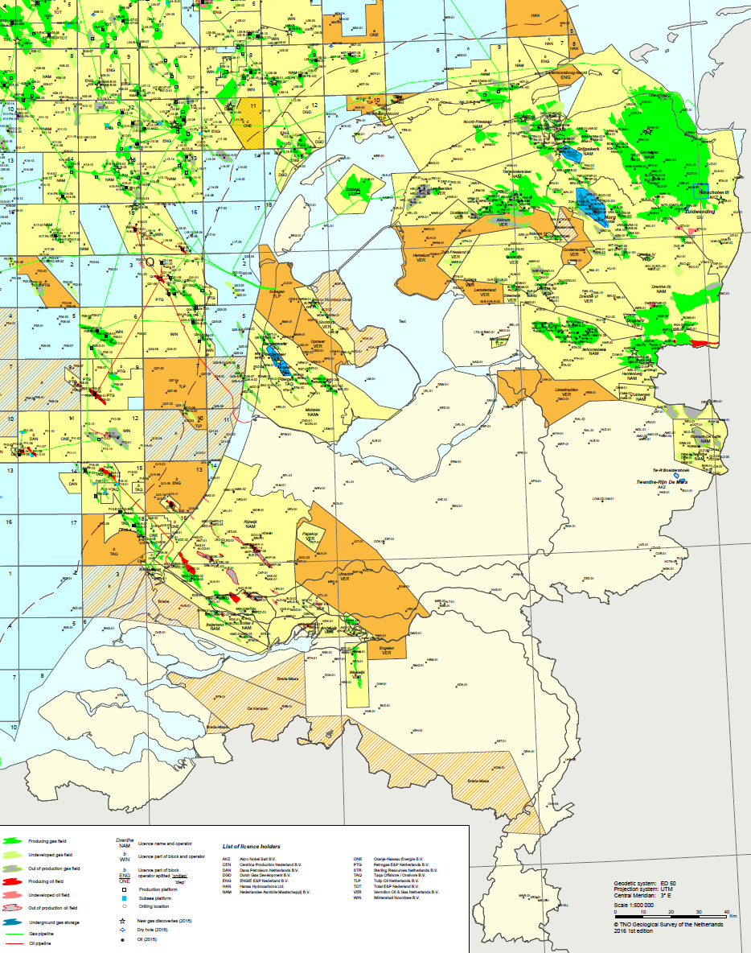
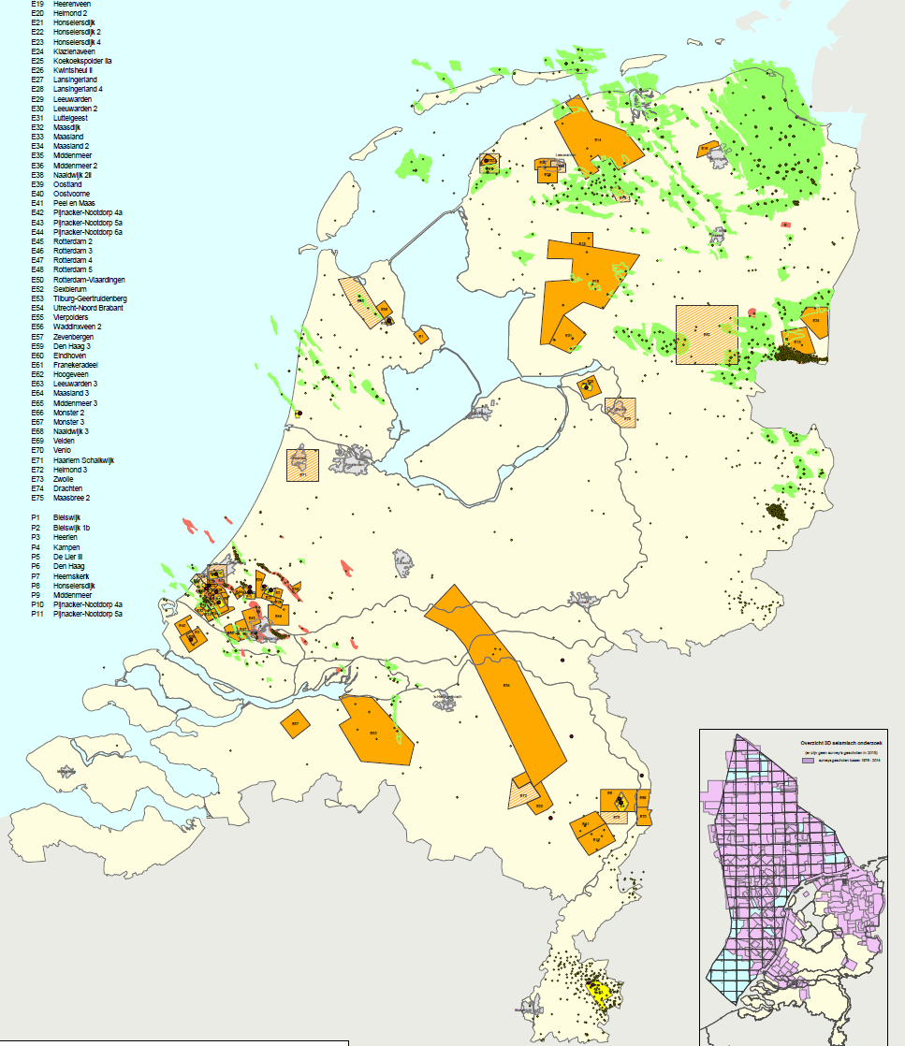
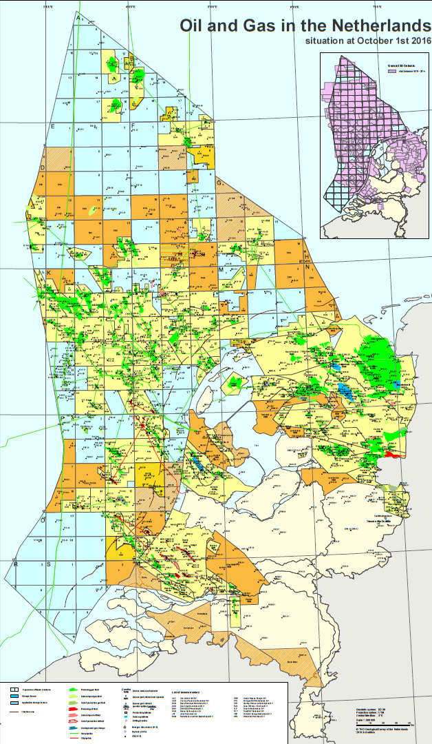
Licences: oil & gas ⬄ Geothermal
Exploration lic.
Production lic.
Gas field
Oil field
well
Source: Natural resources and geothermal energy in the Netherlands
Annual review 2015, MEA

Slide 4
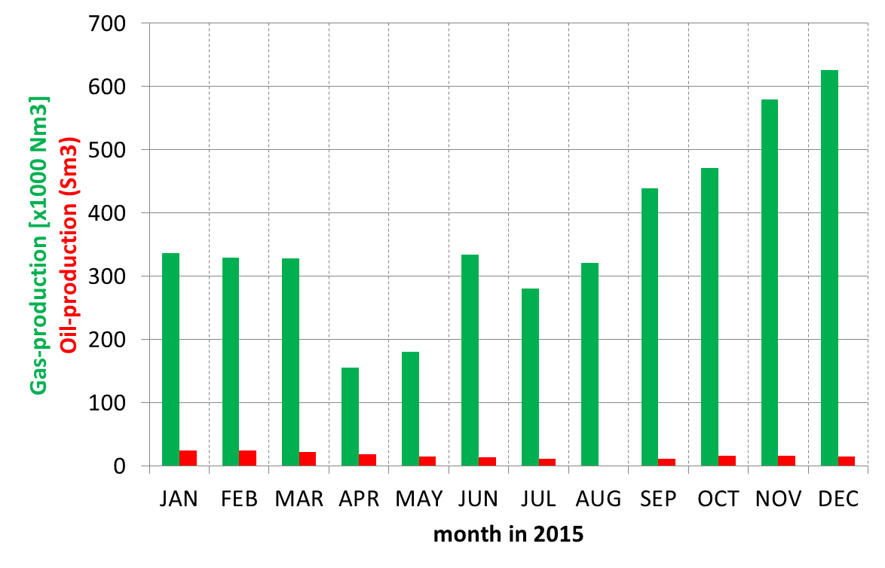
production: oil, gas & GT-heat
Production volumes in 2015 of subsurface energy resources
Production type | Volume | Energy (PJ)
Gas | 49.8 *10⁹ Nm³ | 1750
Oil | 1.7 *10⁶ Sm³ | (≈66)
Condensate | 532 *10³ Sm³ | (≈21)
Heat by-catch Oil Co-prod. Gas | 2.4 PJ 186 Sm³ 4.4 *10⁶ m³ | 2.4 (≈0.007) 0.16
Co-produced Gas in geothermal production;
1 to 2 m³/m³
Source: Natural resources and geothermal energy in the Netherlands
Annual review 2015, MEA

Slide 5
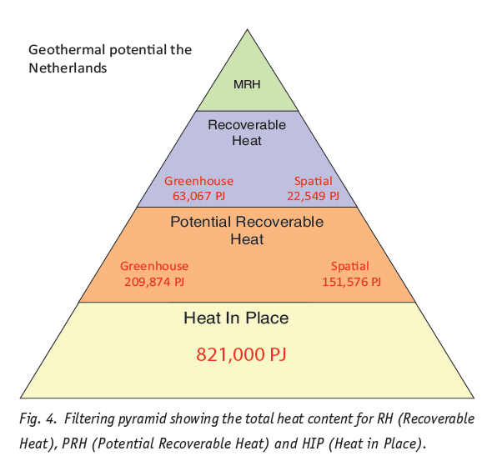
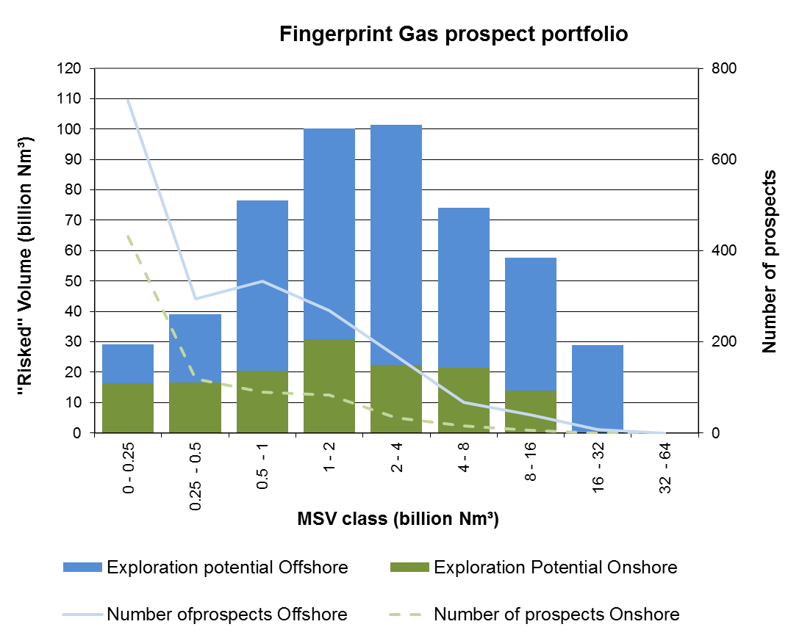
Resources: Exploration potential
Scenario; Values in (bcm) | Med estimate no cut-off | Expected value @ EMV=0, gas price 14 ct/m³ | Expected value @ EMV=0, gas price 21.5 ct/m³
Onshore | 142 | 99 | 116
Offshore | 365 | 94 | 161
Total | 507 | 193 | 277
18000 PJ
7000 PJ
Source: Natural resources and geothermal energy in the Netherlands
Annual review 2015, MEA
Kramers et al. 2012

Slide 6
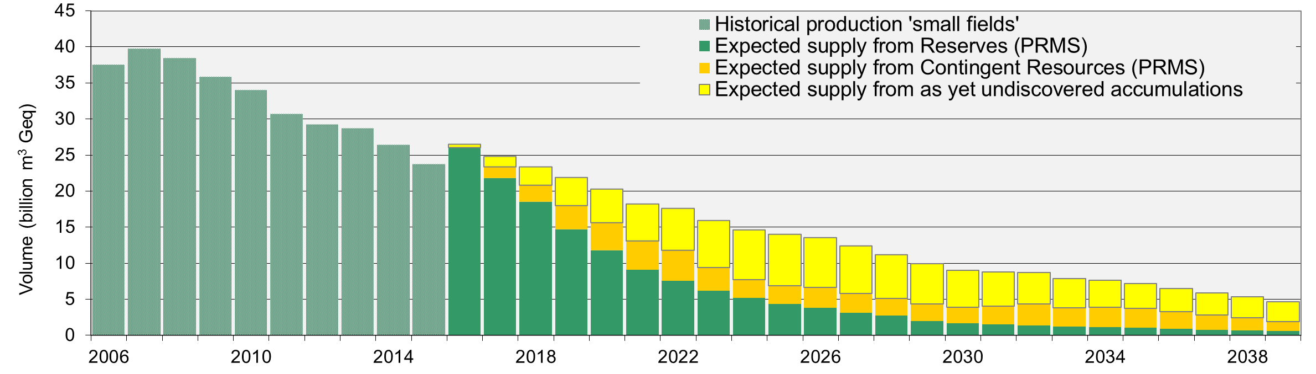
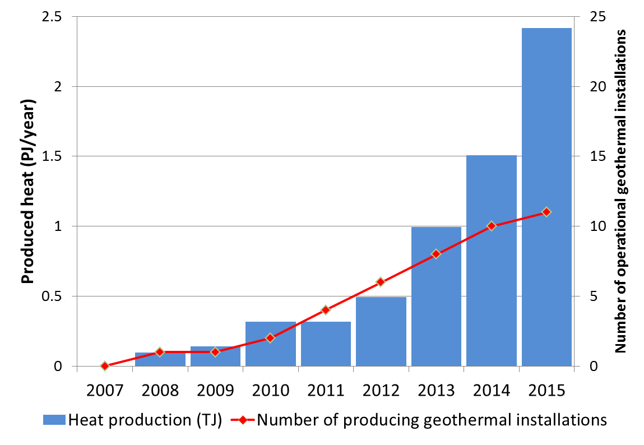
Resources: Future production
850 PJ
Exclusive 28.2 bcm Groningen production
Oil and gas resources in decline mode
Geothermal in rising mode
2.4 PJ
Source: Natural resources and geothermal energy in the Netherlands
Annual review 2015, MEA

Slide 7
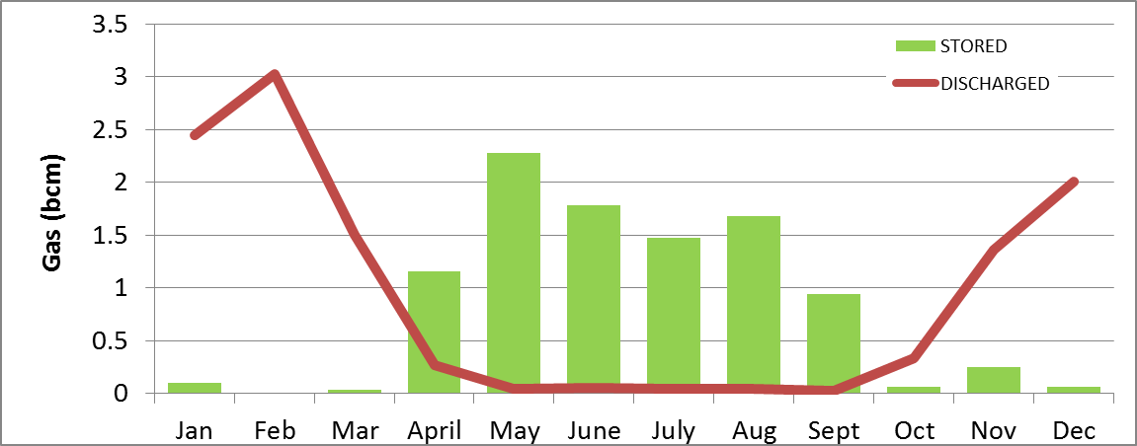
Geological Gas Buffering

Slide 8
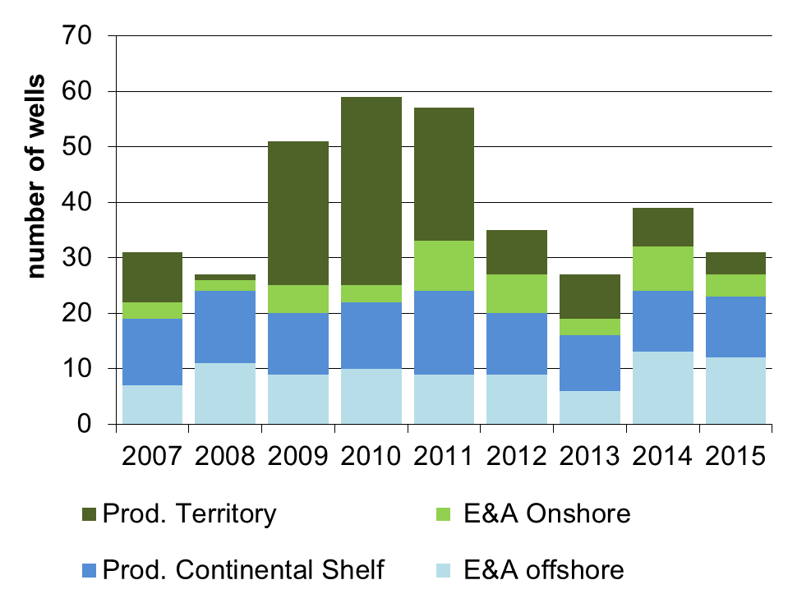
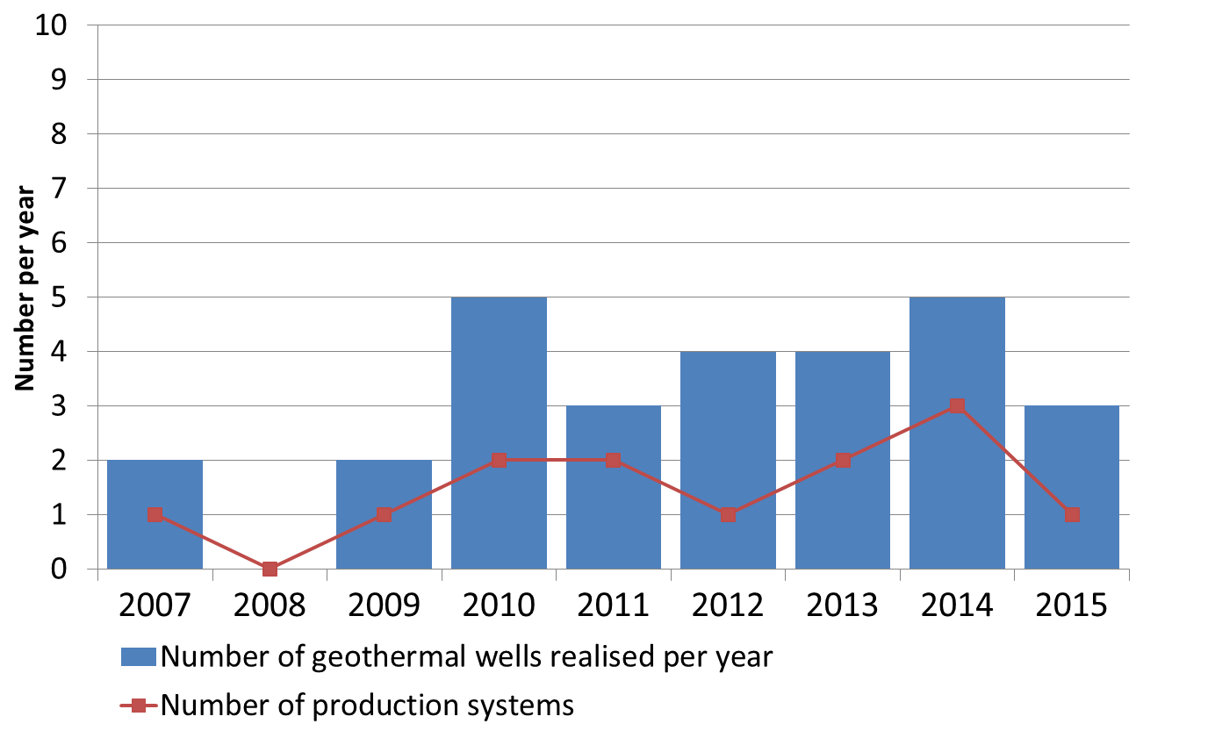
E&P wells drilled
Oil & gas E&P
Geothermal E&P
6
19
2016
2016
Prelim. figures
 | Production | Explo/appr
Onshore | 9 | 1
offshore | 4 | 5
2016: 6 wells
Source: Natural resources and geothermal energy in the Netherlands
Annual review 2015, MEA

Slide 9
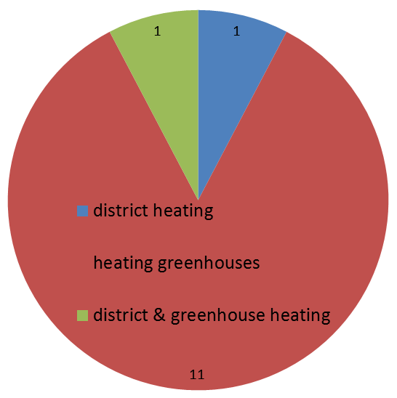
Use of gas and Geothermal energy
Number and use of
Geothermal installations
In 2013 approx. 45 bcm gas used:
  2% - for the production of gas
  15% - electricity production
  32% - industrial processes
  51% - built environment and SMEs
        Source CBS 2014
Some 30-50% (500-800 PJ) used for low enthalpy heat
Ideal target for replacement by geothermal heat
Energy production in 2015
= 2.4 PJ
Source: Natural resources and geothermal energy in the Netherlands
Annual review 2015, MEA

Slide 10
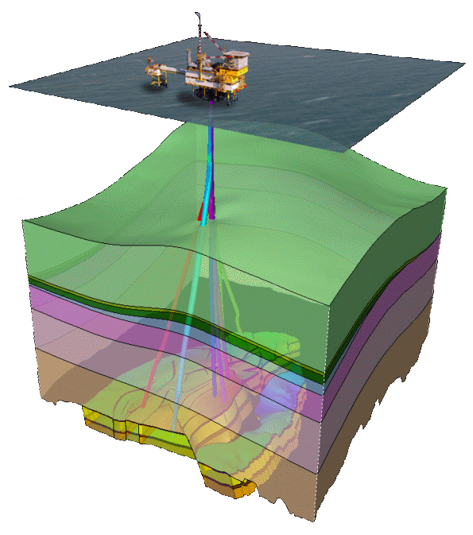
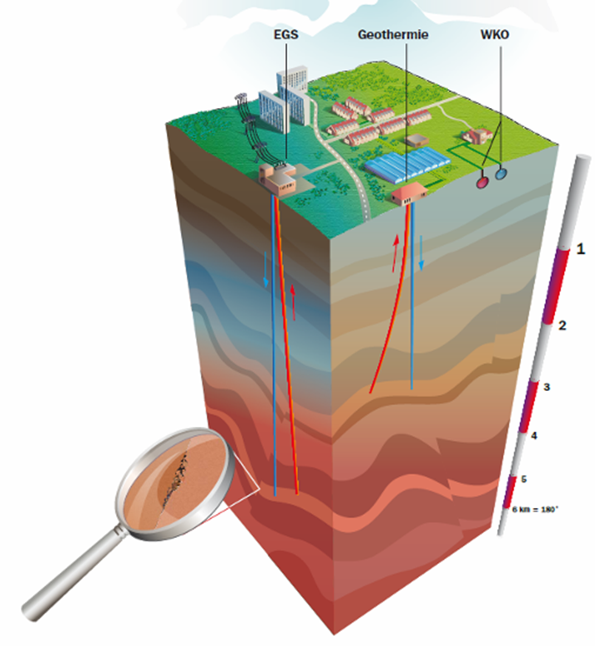
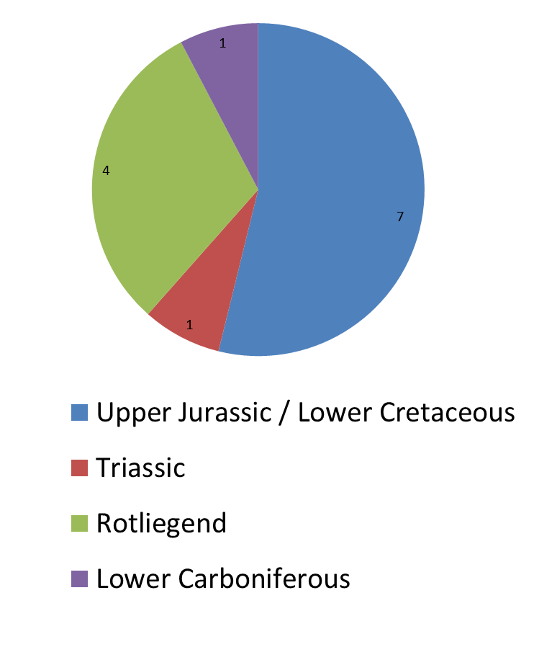
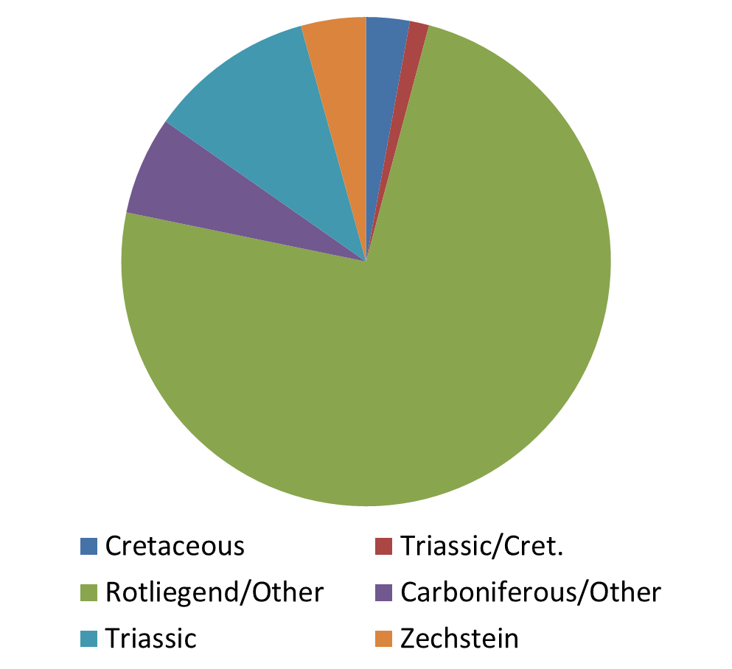
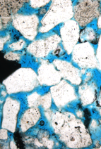
Resource: target stratigraphy
Stratigraphy of Gas fields
Stratigraphy of Geothermal systems
Source: Natural resources and geothermal energy in the Netherlands
Annual review 2015, MEA

Slide 11
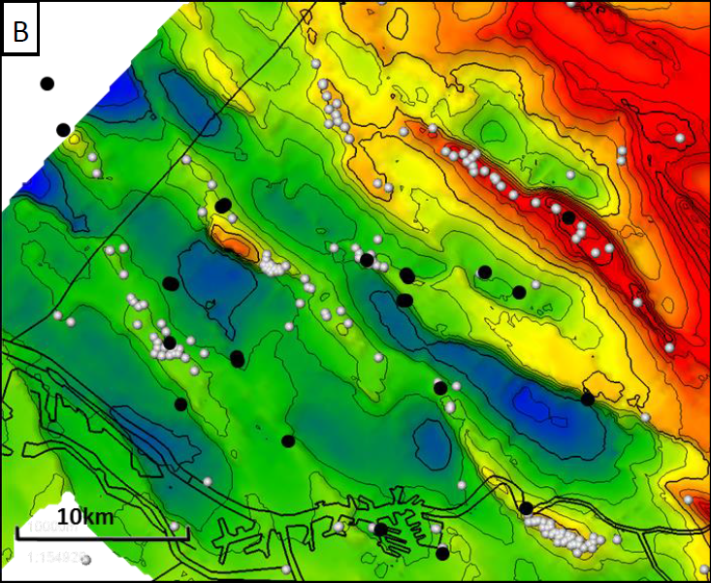
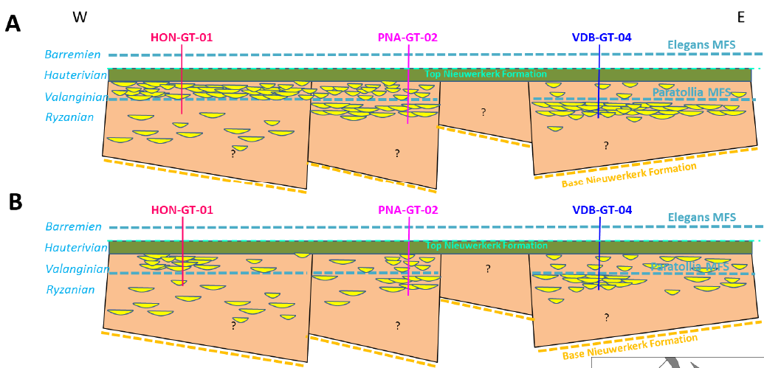
down dip / graben play
GT wells
Geothermal targets are in the graben settings
  Additional data on:
    Reservoir properties as porosity and permeability
    Reservoir distribution: thickness, N/G
    Better reservoir models
Ref: Vondrak, A.G., 2016. (Bio-) stratigraphic correlation of geothermal aquifers in the West Netherlands Basin. PanTerra Geoconsultants B.V.

Slide 12
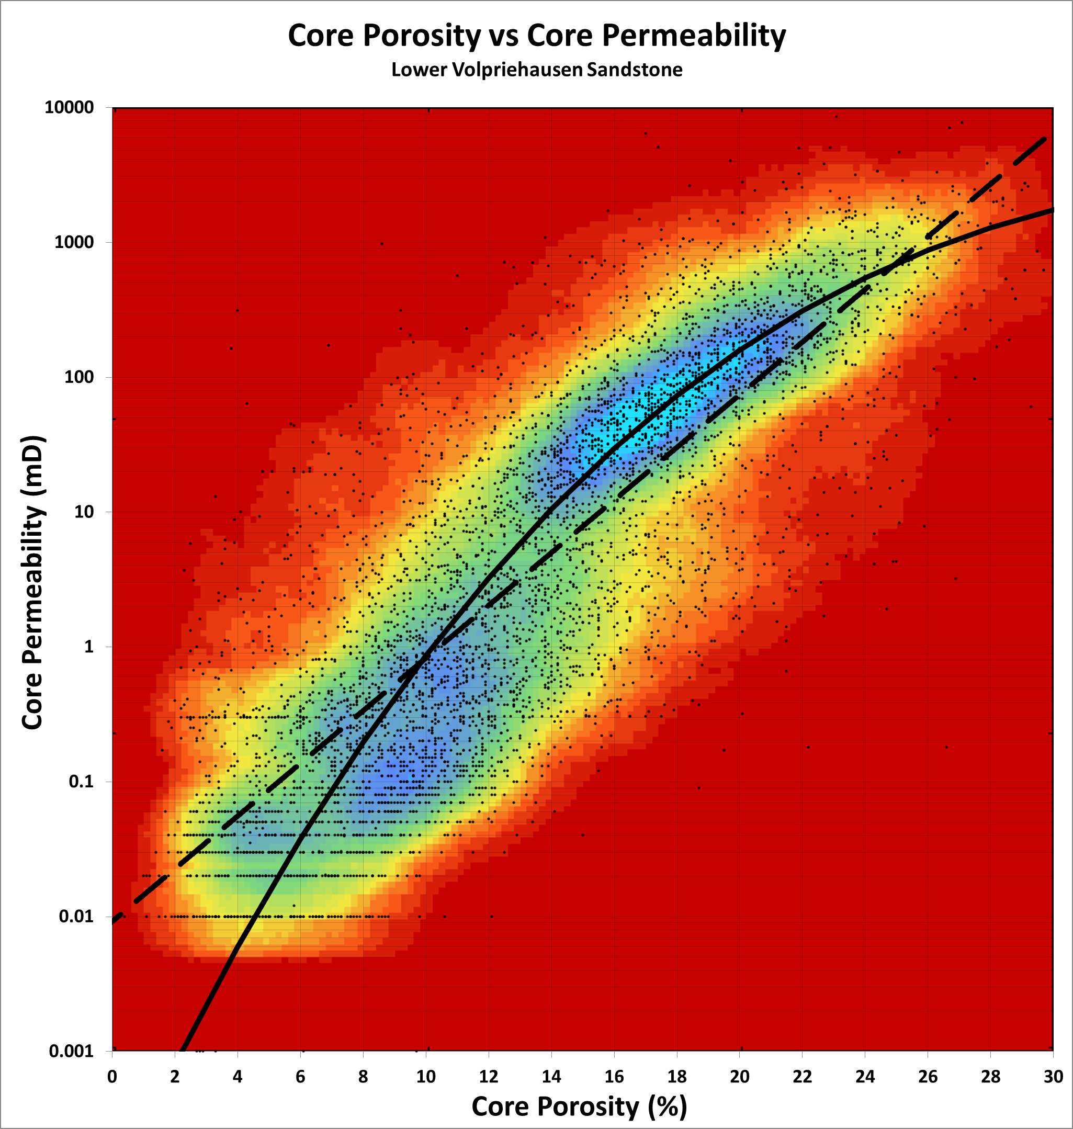
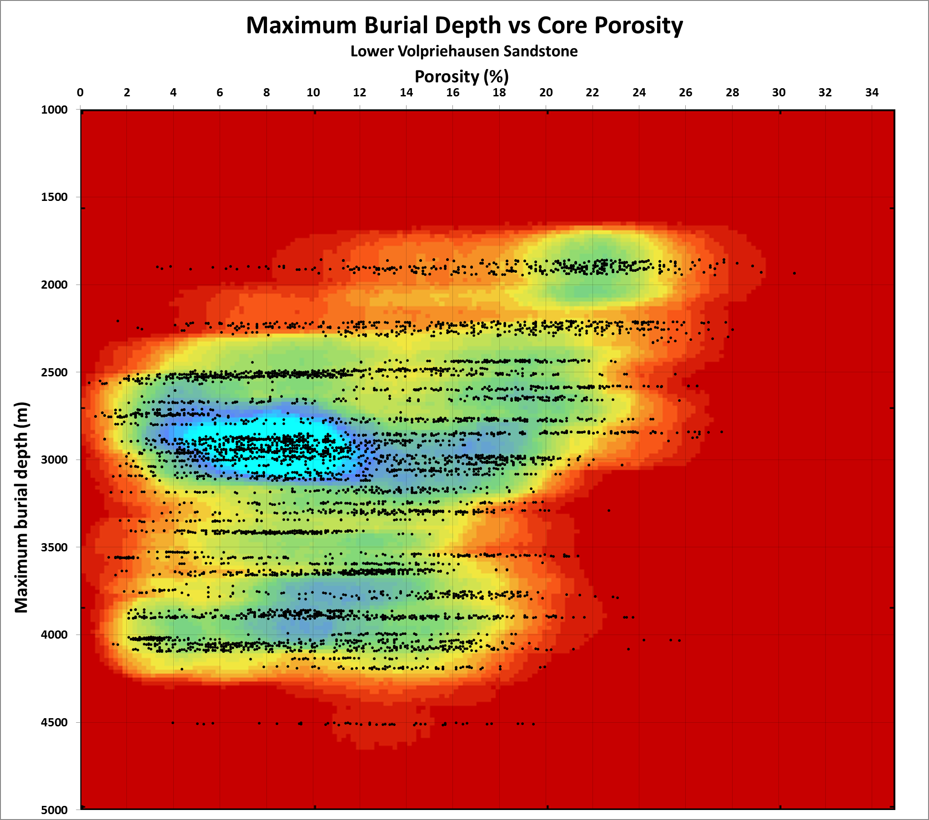
Sharing data and evaluations
Dutch Oil and Gas Portal www.nlog.nl
Porosity range → Facies and Diagenesis
High Porosity envelope → Burial
Van Kempen et al 2016.

Slide 13
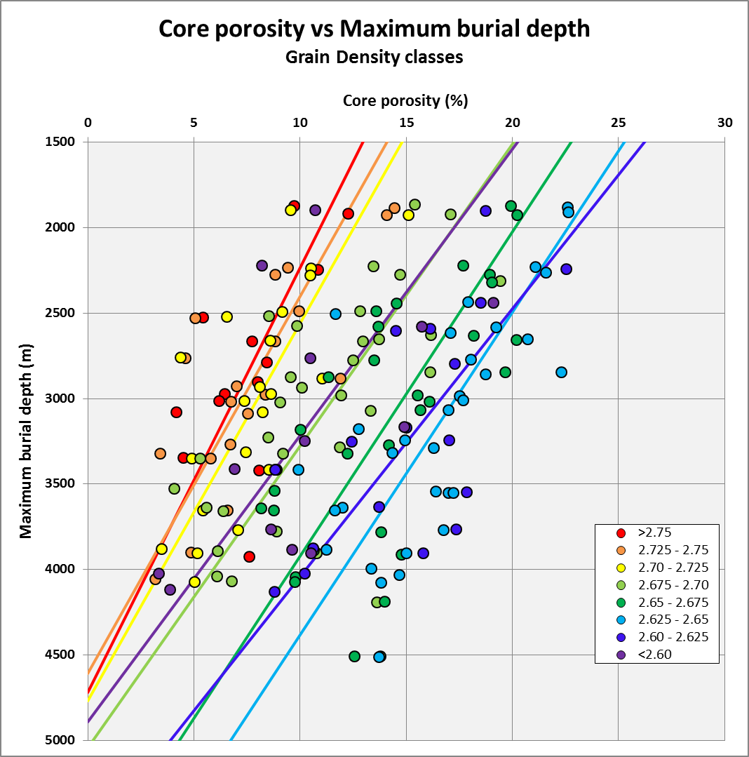
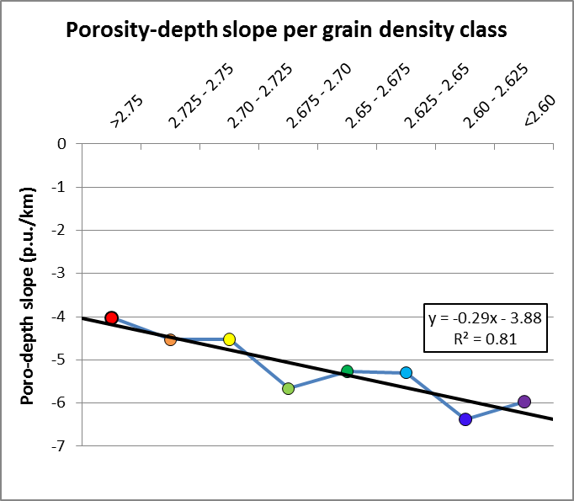
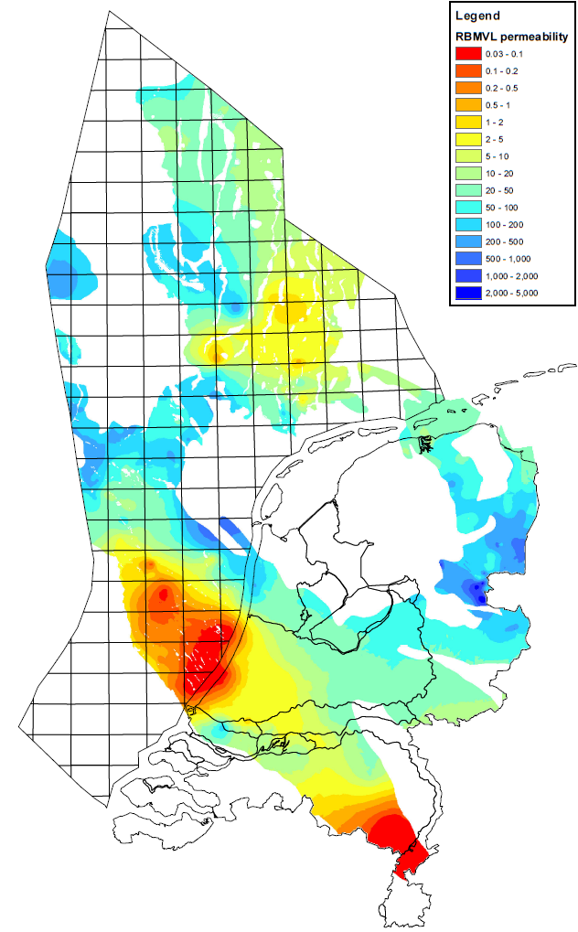
Sharing data and evaluations
Van Kempen et al 2016.
Permeability distribution Lower Volpriehausen

Slide 14
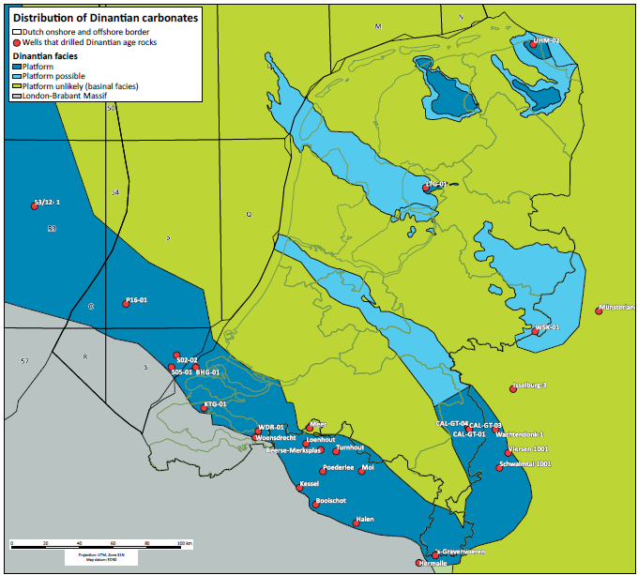
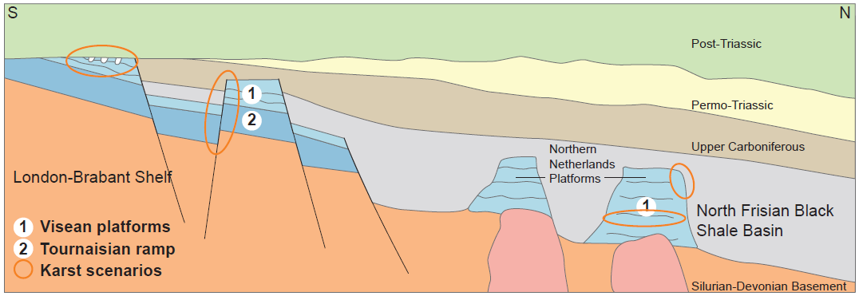
Exploration Synergy– Dinantian play
Reservoir stratigraphy:
  Dinantian Carbonate
  (Devonian Carbonates)
  (Devonian Sandstones)
Play types:
  Karst
  Fractures
  Faults
HC exploration
HC exploration
HC exploration
GT exploration

Slide 15
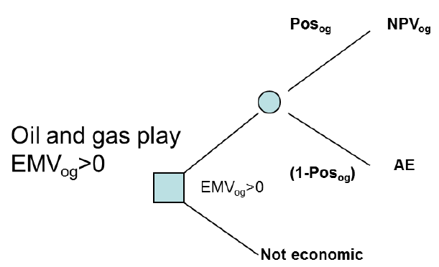
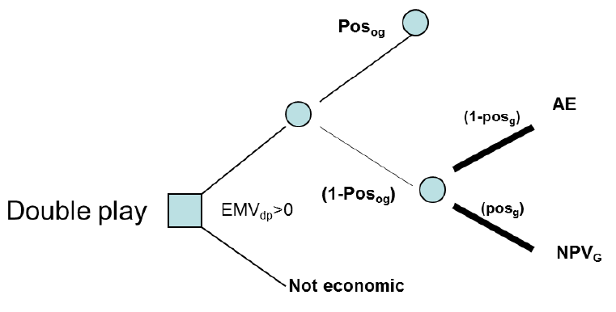
Exploration Synergy– risk sharing 1
Postpone or defer abandonment costs
discovery
discovery
drill
Dry hole
no
drill
Dry hole
Geothermal option
yes
No drill
No drill
AE = abandonment)
Ref: Van Wees, J.D. et al., 2015, . Geothermal and Hydrocarbon Exploration: the Double Play Synergy, Proceedings World Geothermal Congress Melbourne, Australia, 19-25 April 2015

Slide 16
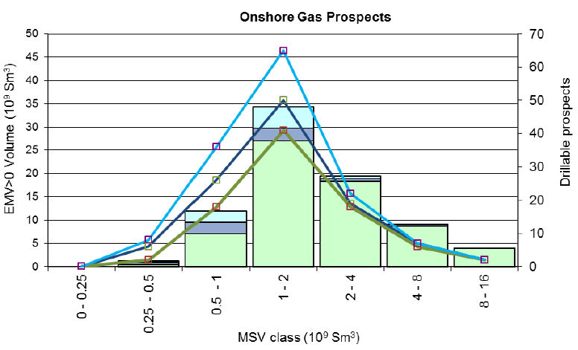
Exploration Synergy– risk sharing 2
Gas only scenario when POSg=0.7 – 65 bcm
Risk sharing scenario when POSg=0.3 – 72 bcm
Risk sharing scenario when POSg=0.7 – 82 bcm
Nbr of economic prospects gas only
Nbr of econ. prospects Risk sharing when POSg=0.3
Nbr of econ. prospects Risk sharing when POSg=0.7

Slide 17
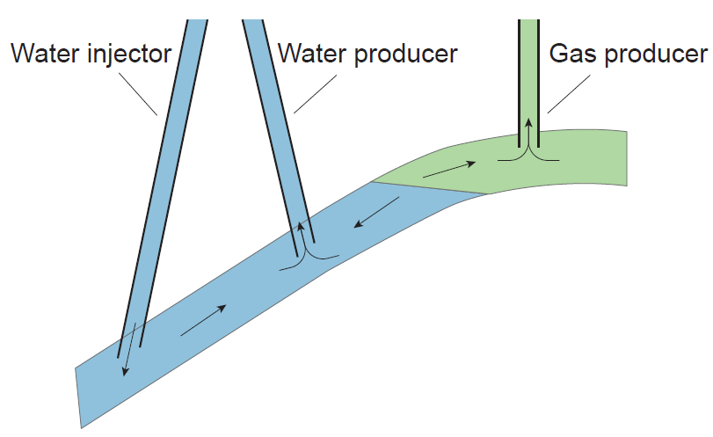
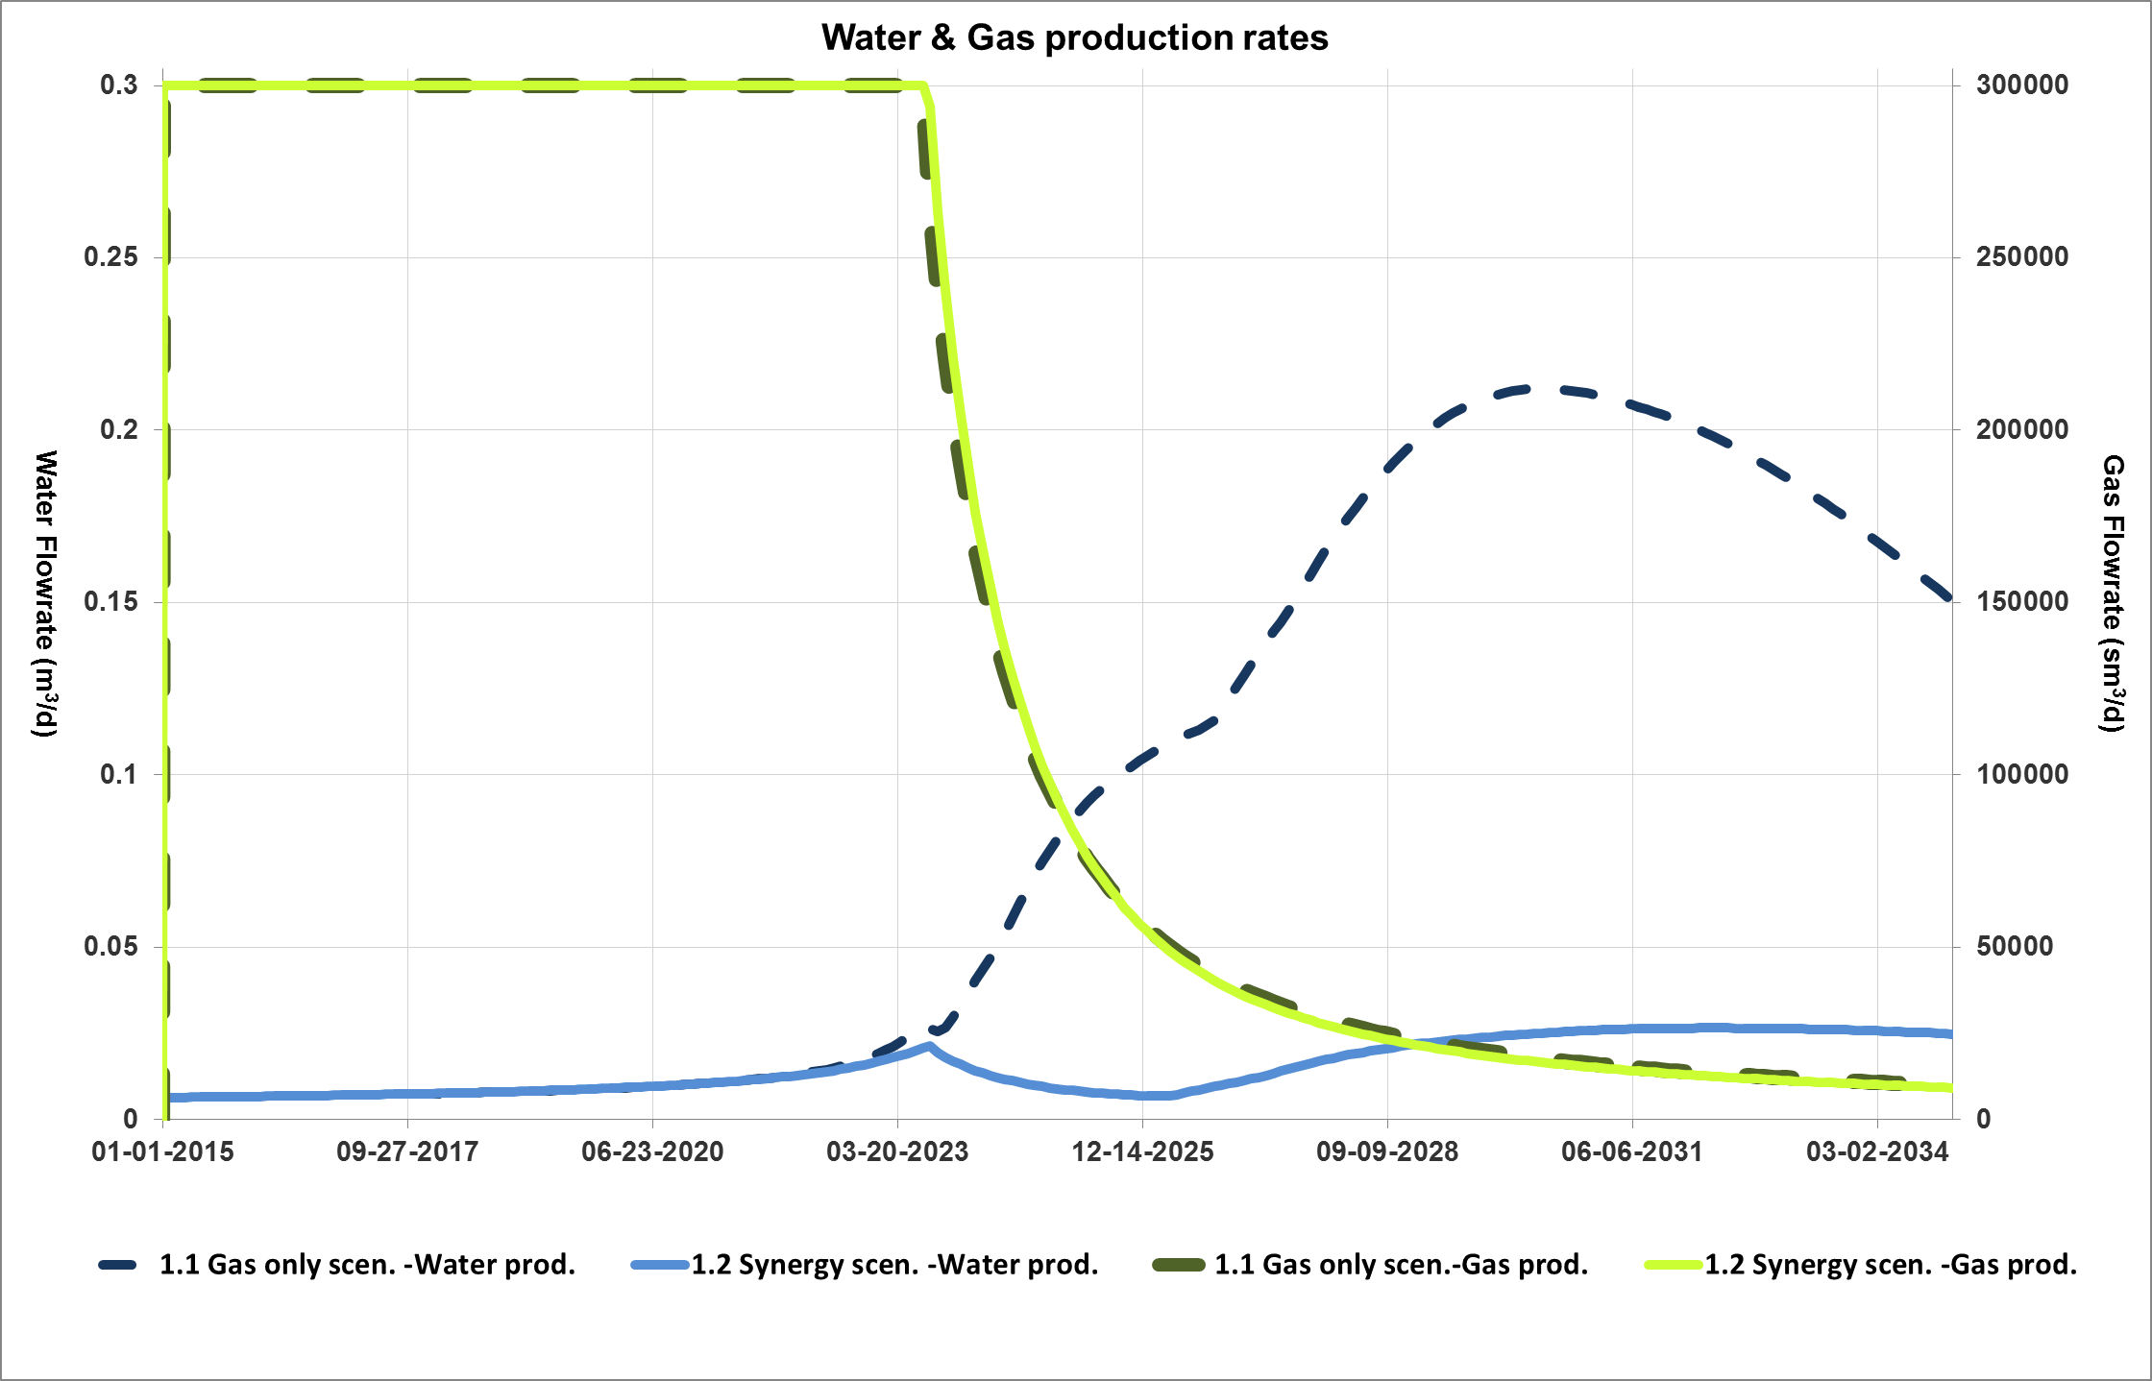
Dual Development Synergy
Increased Gas recovery due to postponed water breakthrough
Requirements: active aquifer, high permeability
Small GIIP fields => stand alone development local use of heat and/power

Slide 18
Synergy: re-use of oil & gas wells
Bore hole heat exchanger => low energy recovery
Part of a doublet system
  Gas-2-Geothermal well, demonstration project @ depleted Middenmeer gasfield
Refs: http://www.rvo.nl/subsidies-regelingen/projecten/g2g-van-gas-naar-geothermie

Slide 19
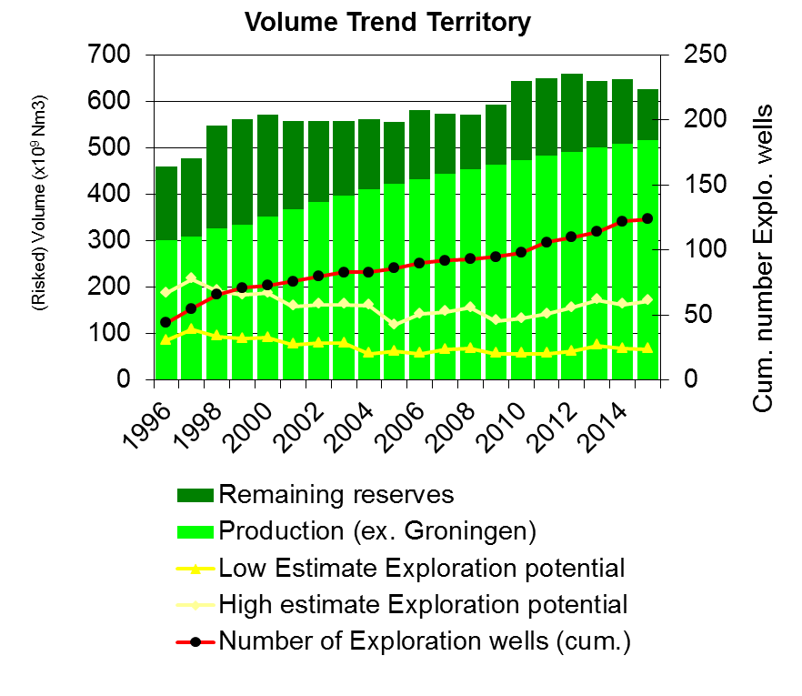
Replenishment
Old:
  portfolio replenishment of newly mapped prospect in the portfolio.
New:
  Strategically located gas field replenishment → gas buffering from distant sources →present gas storages
Future?:
  Power to Gas & vice versa Gas to Power (like hydro-power)
    Security of supply from windfarms
    Use power cables & avoid pipeline costs

Slide 20


Future energy (security of) supply
– the role of the subsurface
Gas
Heat & cold grid
Gas
GT
GT
G2P
&
P2G
Development synergy
Exploration synergy
Gas grid
G2GT-wells

Slide 21
Dutch situation
All ingredients available:
  Sizeable gas prospect portfolio
  Developing geothermal sector
  Multiple options for synergy with geothermal development
  Variety of financial support schemes for E&P and Energy innovation projects
  Innovative subsurface use for security of supply
  Synergy and integration!

Slide 22
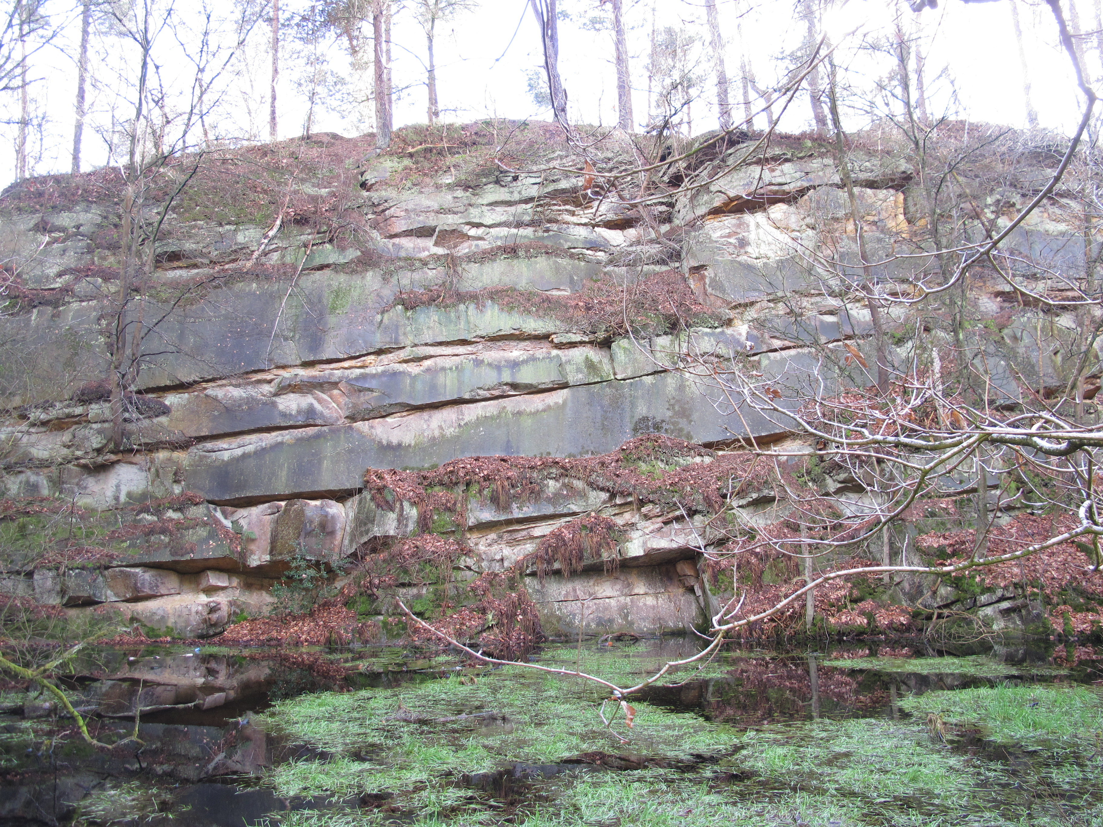
Thank you for your attention
Hope to see you in booth 10

