Slide 1
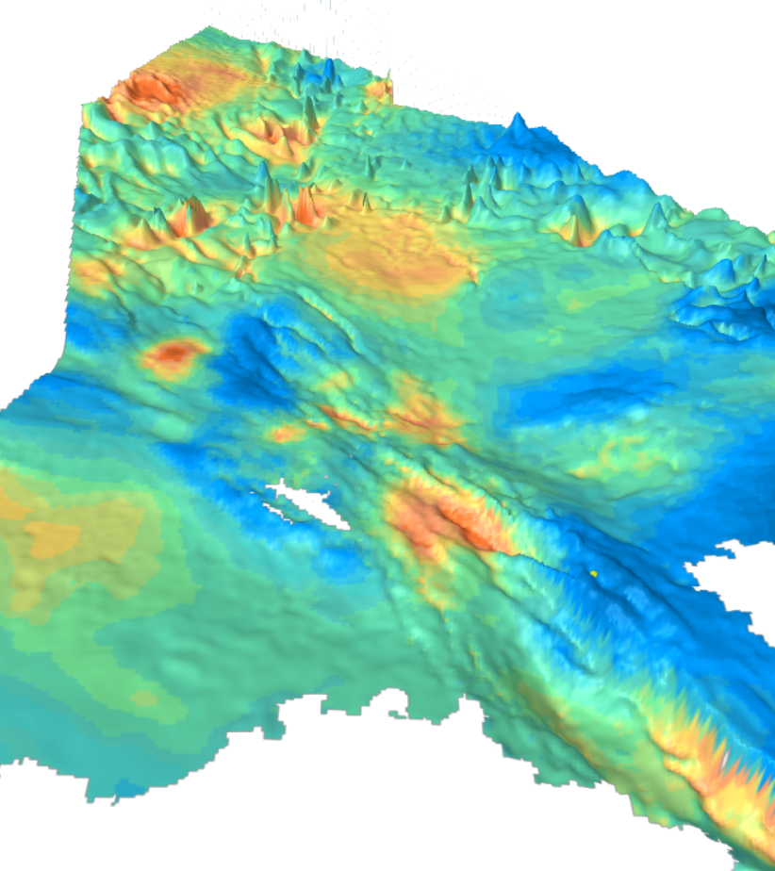


VELMOD-4b
A new regional velocity model for the Netherlands
Prediction improvement: up to 30%
March 2019
contact-norway@estimages.com
Tel: + 47 22 60 02 85

Slide 2
Timeline
February 2017
Agreement between Estimages and TNO
March 2017
Pilot Project
October 2017
End of data integration in the project
May 2018
Completion of VELMOD-4a
November 2018
Completion of VELMOD-4b
February 2019
Evaluation by TNO (blind wells)

Slide 3
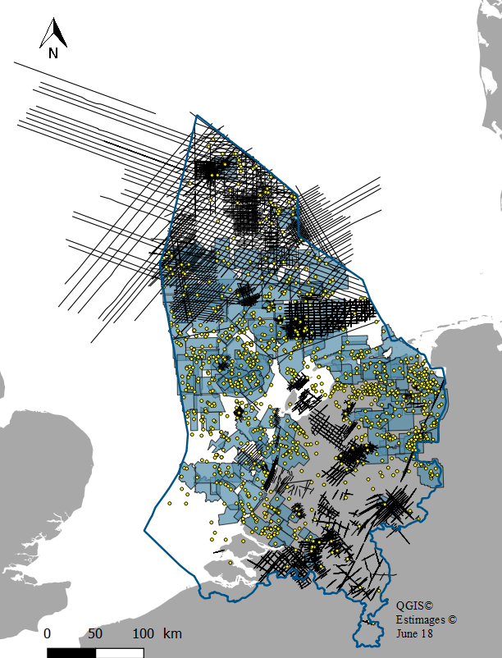
Key features
Integration of seismic velocities
VELMOD-4b is the first VELMOD integrating seismic velocities. The use of seismic velocities reduces prediction errors in areas with no wells.
New data
VELMOD-4b integrates the latest seismic and well data available over the Netherlands (onshore and offshore).
Optimized multi-variate model (M-GS® technology)
VELMOD-4b is the first VELMOD to propose a VINT model reconciling well time-depth functions, well tops and horizons. Geostatistical parameters are determined layer by layer through a prediction errors minimization process.
PREDICTION IMPROVEMENT
+5% to +30% in the intervals (blind wells estimation)
Area
3D seismic velocity data sets
2D seismic velocity data sets
Wells
Regional horizons
100 000 km²
179
136
1642
9

Slide 4

Flowchart
RAW SEISMIC VELOCITIES
2D & 3D
QUALIFIED SEISMIC VELOCITIES
2D & 3D
MERGE SEISMIC VELOCITY VOLUME
QC, CONDITIONING,
GEOSTATISTICAL FILTERING
3D M-GS® GRIDDING
(NON STATIONARY KRIGING)
CALIBRATED SEISMIC VELOCITY VOLUME
1
2
3D M-GS® CALIBRATION
STRATIGRAPHIC GRID
VELMOD-4a
WELL TIME DEPTH FUNCTIONS
(checkshots, sonics...)
3
AUXILIARY VARIABLE
V0, k & VINT AT WELL LOCATIONS
V0, VINT FOR EACH FORMATION
LAYER CAKE, V0-k PARAMETERIZATION
V0 & VINT SPATIALIZATION
M-GS® CO-KRIGING
VELMOD-4b
Independant TNO process
4
HORIZONS (TWT)
AUXILIARY VARIABLE
VINT AT WELL LOCATIONS
V0, VINT FOR EACH FORMATION
VINT RESIDUAL CALIBRATION
FKED
VELMOD-4b
FINAL
WELL TOPS
5

Slide 5
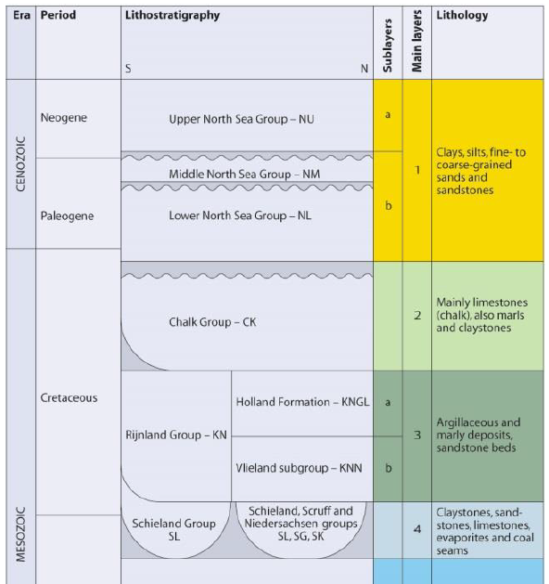
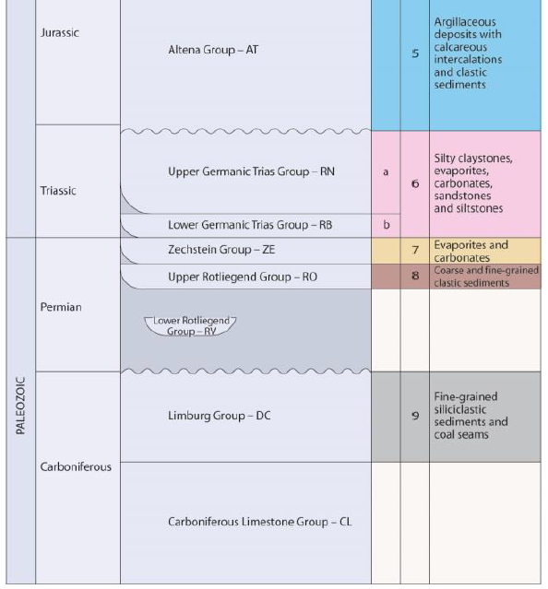
Formations
NU
Upper North Sea Group
NLM
Middle and Lower North Sea Group
CK
Chalk Group
KN
Rijnland Group
SAT
Schieland and Altena Group
RNB
Upper and Lower Germanic Trias Group
ZE
Zechstein

Slide 6
VELMOD-4 building

Slide 7
Flowchart
QUALIFIED SEISMIC VELOCITIES
2D & 3D
RAW SEISMIC VELOCITIES
2D & 3D
QUALIFIED SEISMIC VELOCITIES
2D & 3D
MERGE SEISMIC VELOCITY VOLUME
RAW SEISMIC VELOCITIES
2D & 3D
QC, CONDITIONING,
GEOSTATISTICAL FILTERING
QC, CONDITIONING,
GEOSTATISTICAL FILTERING
3D M-GS® GRIDDING
(NON STATIONARY KRIGING)
CALIBRATED SEISMIC VELOCITY VOLUME
1
1
2
3D M-GS® CALIBRATION
STRATIGRAPHIC GRID
VELMOD-4a
WELL TIME DEPTH FUNCTIONS
(checkshots, sonics...)
3
AUXILIARY VARIABLE
V0, k & VINT AT WELL LOCATIONS
V0, VINT FOR EACH FORMATION
LAYER CAKE, V0-k PARAMETERIZATION
V0 & VINT SPATIALIZATION
M-GS® CO-KRIGING
VELMOD-4b
Independant TNO process
4
HORIZONS (TWT)
AUXILIARY VARIABLE
VINT AT WELL LOCATIONS
V0, VINT FOR EACH FORMATION
VINT RESIDUAL CALIBRATION
FKED
VELMOD-4b
FINAL
WELL TOPS
5

Slide 8
QC & conditioning of the seismic velocities
Qualified data base
Standard geostatistical QC of the 2D and 3D seismic velocity data sets
(statistics, variographic analysis…)
Resolution preserved
3D geostatistical filtering
No smoothing operator such as gaussian or median filter
etc.

Slide 9
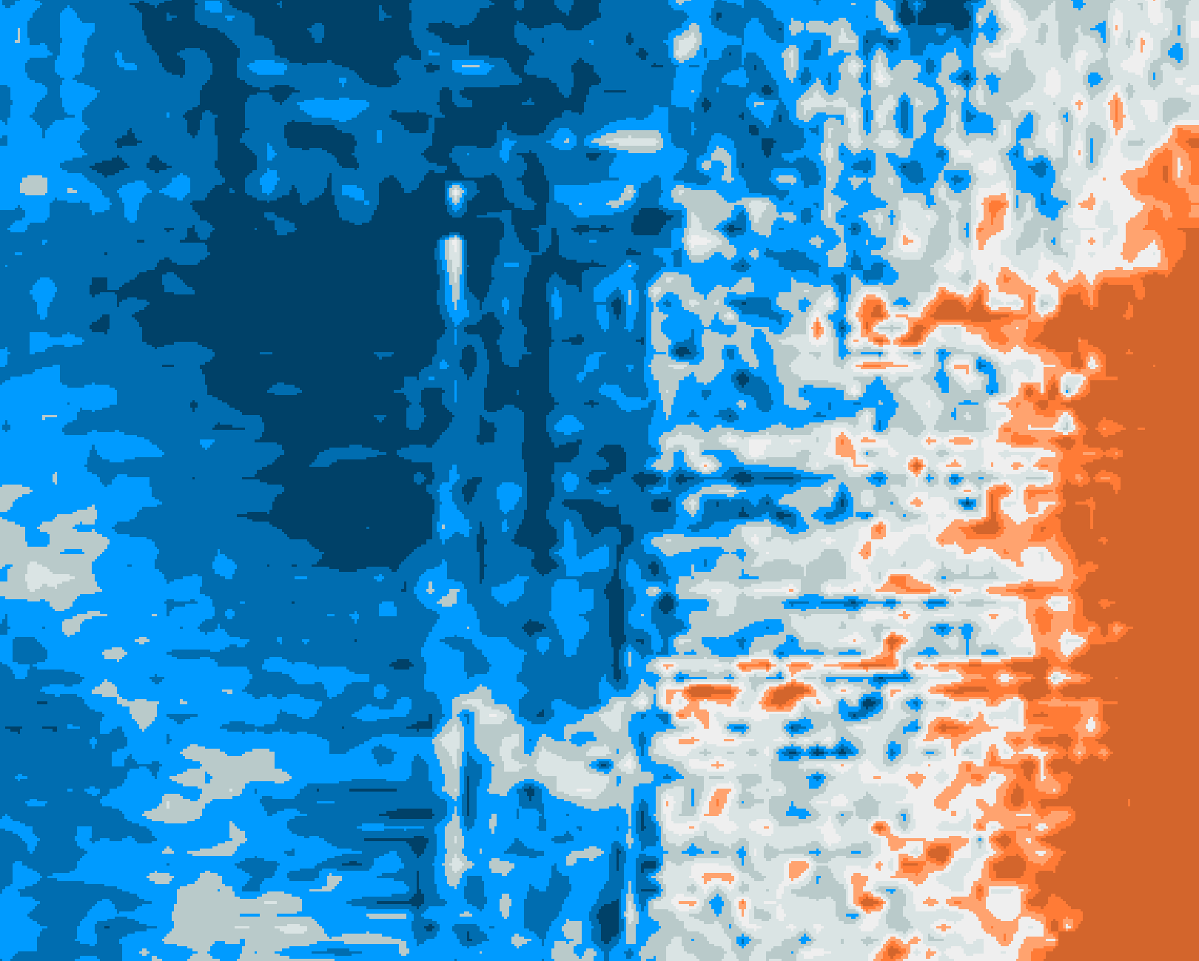
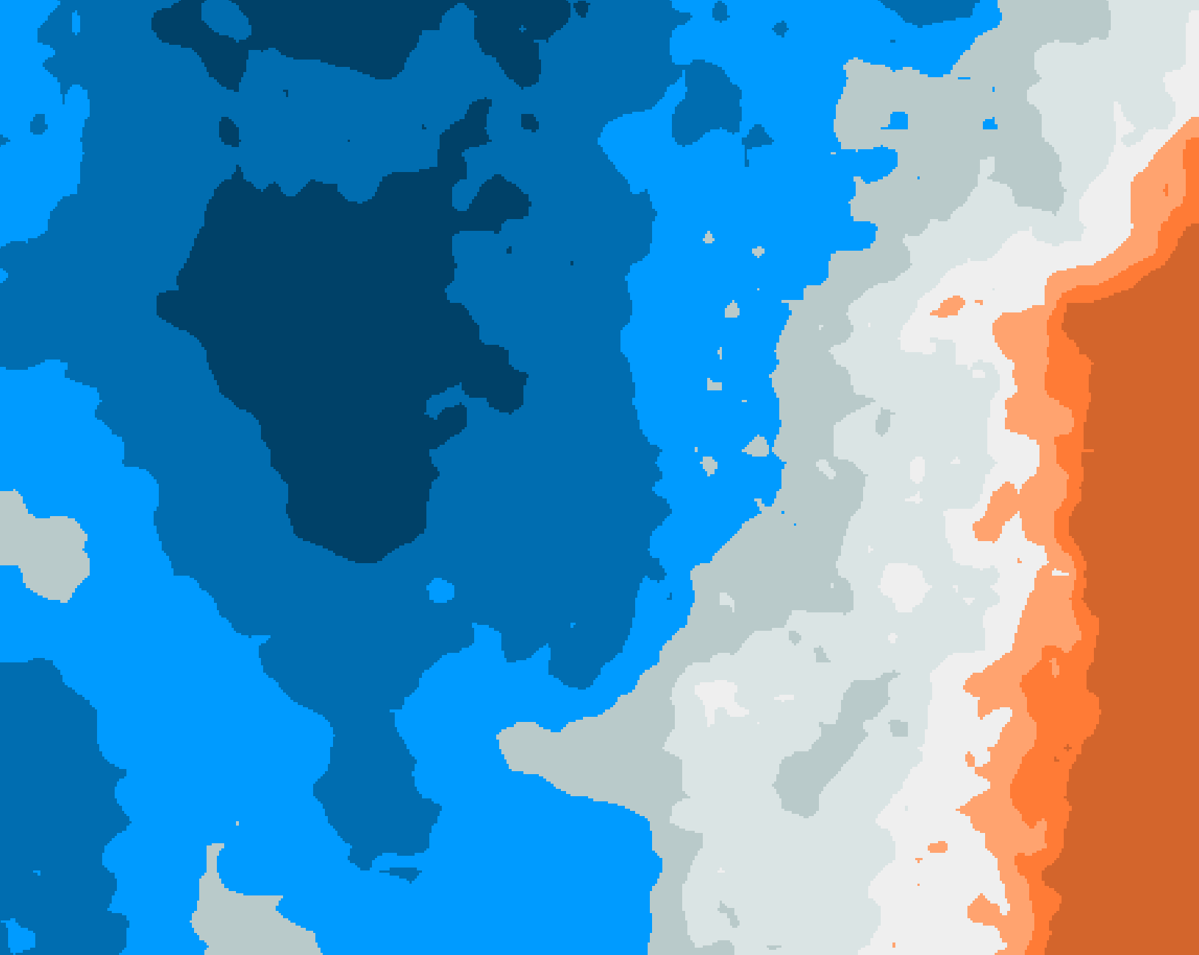
QC & conditioning of the seismic velocities
RAW
FILTERED
3D geostatistical filtering

Slide 10
Flowchart
QUALIFIED SEISMIC VELOCITIES
2D & 3D
MERGE SEISMIC VELOCITY VOLUME
RAW SEISMIC VELOCITIES
2D & 3D
QUALIFIED SEISMIC VELOCITIES
2D & 3D
MERGE SEISMIC VELOCITY VOLUME
QC, CONDITIONING,
GEOSTATISTICAL FILTERING
3D M-GS® GRIDDING
(NON STATIONARY KRIGING)
3D M-GS® GRIDDING
(NON STATIONARY KRIGING)
CALIBRATED SEISMIC VELOCITY VOLUME
1
2
2
3D M-GS® CALIBRATION
STRATIGRAPHIC GRID
VELMOD-4a
WELL TIME DEPTH FUNCTIONS
(checkshots, sonics...)
3
AUXILIARY VARIABLE
V0, k & VINT AT WELL LOCATIONS
V0, VINT FOR EACH FORMATION
LAYER CAKE, V0-k PARAMETERIZATION
V0 & VINT SPATIALIZATION
M-GS® CO-KRIGING
VELMOD-4b
Independant TNO process
4
HORIZONS (TWT)
AUXILIARY VARIABLE
VINT AT WELL LOCATIONS
V0, VINT FOR EACH FORMATION
VINT RESIDUAL CALIBRATION
FKED
VELMOD-4b
FINAL
WELL TOPS
5

Slide 11
3D merge of the seismic velocities
Consistency analysis
between the qualified seismic velocity datasets
Priority rules
In overlap areas definition of priority rules such as 3D > 2D
Merge
Merge by 3D non-stationary factorial kriging driven by the regional structure (M-GS®)

Slide 12
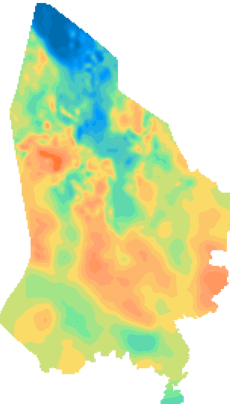

3D merge of the seismic velocities
m/s
Inst. Vel - Time-slice 2sTWT

Slide 13
Flowchart
QUALIFIED SEISMIC VELOCITIES
2D & 3D
MERGE SEISMIC VELOCITY VOLUME
RAW SEISMIC VELOCITIES
2D & 3D
MERGE SEISMIC VELOCITY VOLUME
QC, CONDITIONING,
GEOSTATISTICAL FILTERING
3D M-GS® GRIDDING
(NON STATIONARY KRIGING)
CALIBRATED SEISMIC VELOCITY VOLUME
CALIBRATED SEISMIC VELOCITY VOLUME
1
2
3D M-GS® CALIBRATION
STRATIGRAPHIC GRID
3D M-GS® CALIBRATION
STRATIGRAPHIC GRID
VELMOD-4a
VELMOD-4a
3
WELL TIME DEPTH FUNCTIONS
(checkshots, sonics...)
3
AUXILIARY VARIABLE
V0, k & VINT AT WELL LOCATIONS
V0, VINT FOR EACH FORMATION
LAYER CAKE, V0-k PARAMETERIZATION
V0 & VINT SPATIALIZATION
M-GS® CO-KRIGING
VELMOD-4b
Independant TNO process
4
HORIZONS (TWT)
AUXILIARY VARIABLE
VINT AT WELL LOCATIONS
V0, VINT FOR EACH FORMATION
VINT RESIDUAL CALIBRATION
FKED
VELMOD-4b
FINAL
WELL TOPS
5

Slide 14
3D calibration of the seismic velocities
Computation of the depth residuals
At wells, depth residuals = seismic depth minus TVD
Structural analysis
3D variographic analysis of the depth residuals
2 structures: short scale (difference of resolution between well and seismic information), mid/long scale (mainly due to regional vertical anisotropy)
Calibration
Seismic velocity volume calibrated to the wells by 3D FKED
(Factorial Kriging with External Drift)
Driven by the horizons

Slide 15
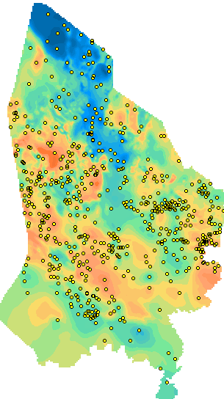
3D calibration of the seismic velocities
m/s
m/s
Inst. Vel - Time-slice 2sTWT
Inst. Vel - Time-slice 2sTWT

Slide 16
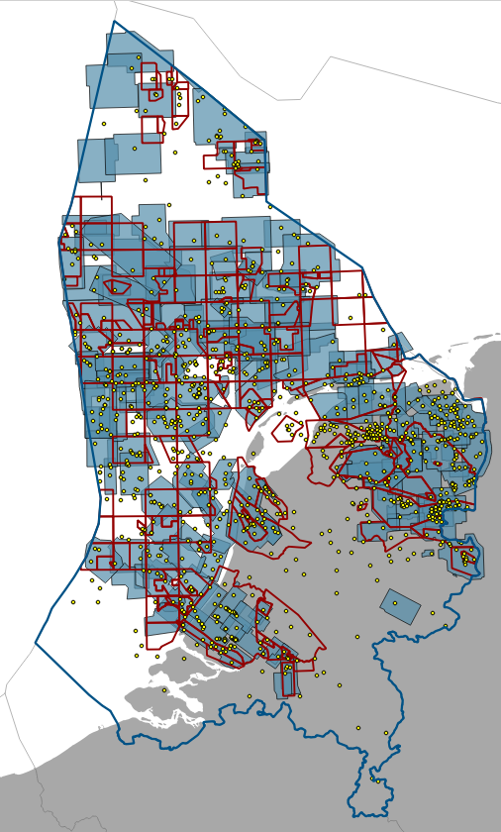
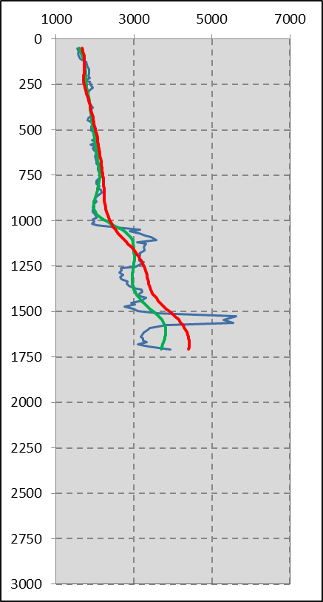
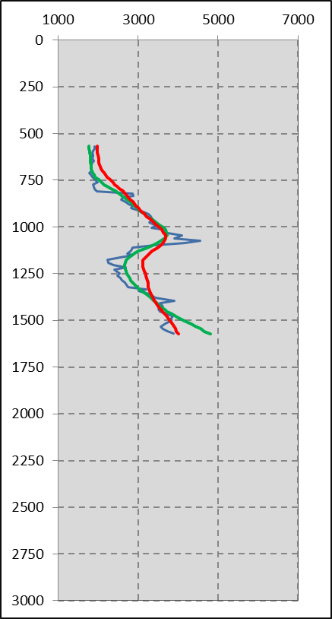
3D calibration of the seismic velocities
Vint (m/s)
Vint (m/s)
Well velocity
Well velocity
Merge
Merge
Calibrated
Calibrated
TWT (ms)
TWT (ms)
OBD-01
P01-04
Basemap

Slide 17
Flowchart
RAW SEISMIC VELOCITIES
2D & 3D
QUALIFIED SEISMIC VELOCITIES
2D & 3D
MERGE SEISMIC VELOCITY VOLUME
QC, CONDITIONING,
GEOSTATISTICAL FILTERING
3D M-GS® GRIDDING
(NON STATIONARY KRIGING)
CALIBRATED SEISMIC VELOCITY VOLUME
CALIBRATED SEISMIC VELOCITY VOLUME
1
2
3D M-GS® CALIBRATION
STRATIGRAPHIC GRID
VELMOD-4a
VELMOD-4a
WELL TIME DEPTH FUNCTIONS
(checkshots, sonics...)
3
WELL TIME DEPTH FUNCTIONS
(checkshots, sonics...)
AUXILIARY VARIABLE
AUXILIARY VARIABLE
V0, k & VINT AT WELL LOCATIONS
V0, k & VINT AT WELL LOCATIONS
V0, VINT FOR EACH FORMATION
V0, VINT FOR EACH FORMATION
LAYER CAKE, V0-k PARAMETERIZATION
LAYER CAKE, V0-k PARAMETERIZATION
V0 & VINT SPATIALIZATION
M-GS® CO-KRIGING
V0 & VINT SPATIALIZATION
M-GS® CO-KRIGING
VELMOD-4b
VELMOD-4b
Independant TNO process
Independant TNO process
4
4
HORIZONS (TWT)
AUXILIARY VARIABLE
VINT AT WELL LOCATIONS
V0, VINT FOR EACH FORMATION
VINT RESIDUAL CALIBRATION
FKED
VELMOD-4b
FINAL
WELL TOPS
5

Slide 18
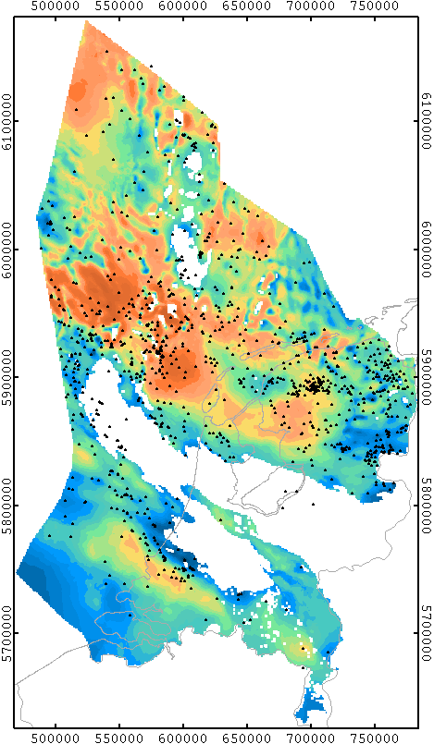

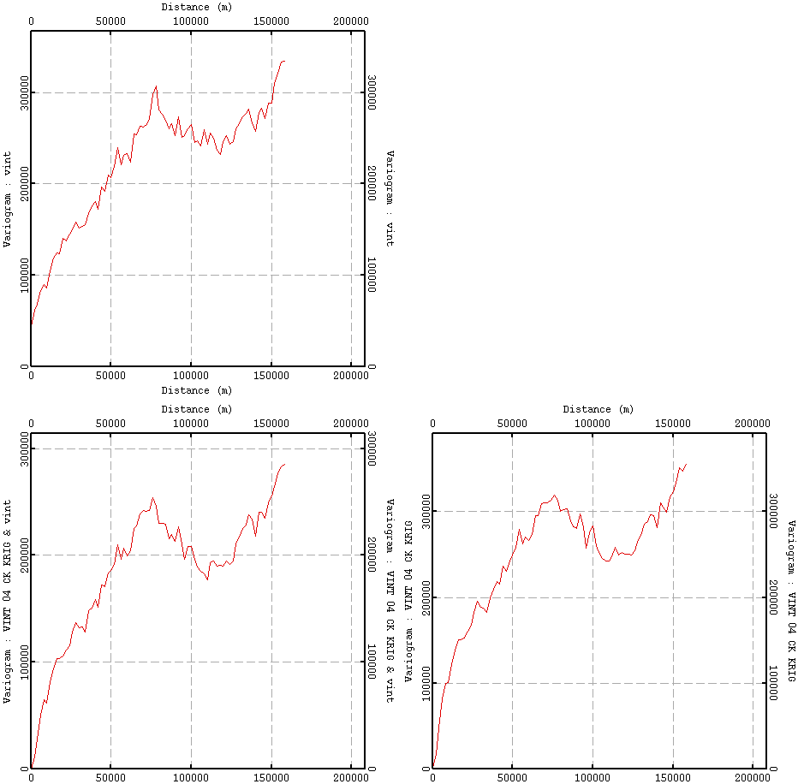
Vint gridding
ILLUSTRATION ON THE CHALK
variability (m²/s²)
Vint_well
CO-KRIGING
m/s
Variogram
lag (m)
variability (m²/s²)
variability (m²/s²)
Vint_well vs Vint_VELMOD-4a
Vint_VELMOD-4a
Correlation 70%
lag (m)
lag (m)
Chalk fm – Interval velocity
Cross-variogram
Variogram

Slide 19
Flowchart
RAW SEISMIC VELOCITIES
2D & 3D
QUALIFIED SEISMIC VELOCITIES
2D & 3D
MERGE SEISMIC VELOCITY VOLUME
QC, CONDITIONING,
GEOSTATISTICAL FILTERING
3D M-GS® GRIDDING
(NON STATIONARY KRIGING)
CALIBRATED SEISMIC VELOCITY VOLUME
1
2
3D M-GS® CALIBRATION
STRATIGRAPHIC GRID
VELMOD-4a
WELL TIME DEPTH FUNCTIONS
(checkshots, sonics...)
3
AUXILIARY VARIABLE
V0, k & VINT AT WELL LOCATIONS
V0, VINT FOR EACH FORMATION
V0, VINT FOR EACH FORMATION
LAYER CAKE, V0-k PARAMETERIZATION
V0 & VINT SPATIALIZATION
M-GS® CO-KRIGING
VELMOD-4b
VELMOD-4b
Independant TNO process
4
AUXILIARY VARIABLE
HORIZONS (TWT)
AUXILIARY VARIABLE
HORIZONS (TWT)
V0, VINT FOR EACH FORMATION
VINT AT WELL LOCATIONS
V0, VINT FOR EACH FORMATION
VINT AT WELL LOCATIONS
VINT RESIDUAL CALIBRATION
FKED
VINT RESIDUAL CALIBRATION
FKED
VELMOD-4b
FINAL
VELMOD-4b
FINAL
WELL TOPS
WELL TOPS
5
5

Slide 20
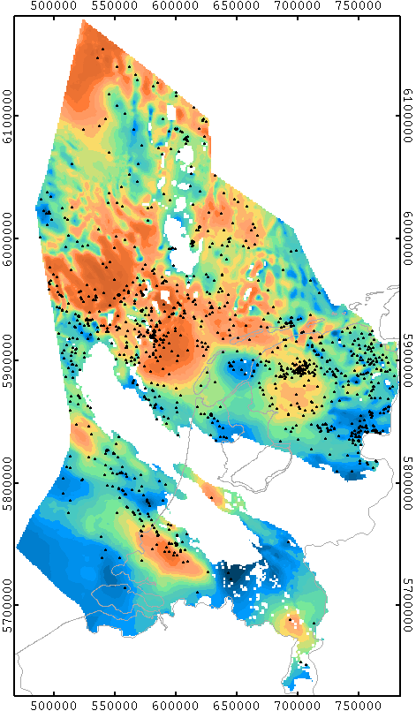
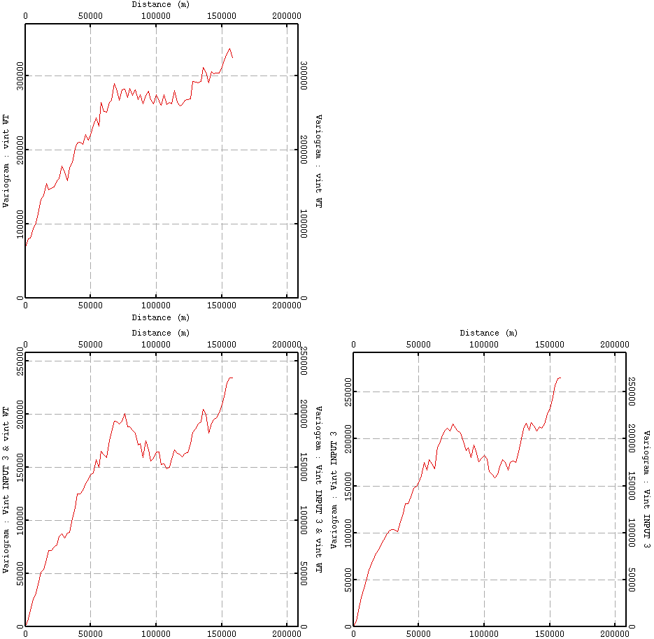
Vint rescaling
ILLUSTRATION ON THE CHALK
variability (m²/s²)
Vint from well tops
FACTORIAL CO-KRIGING
of the large scale structure
m/s
Variogram
lag (m)
variability (m²/s²)
variability (m²/s²)
Vint_well vs Vint_VELMOD-4b
Vint_VELMOD-4b
lag (m)
lag (m)
Chalk fm – Interval velocity
Cross-variogram
Variogram

Slide 21
VELMOD-4 evaluation

Slide 22
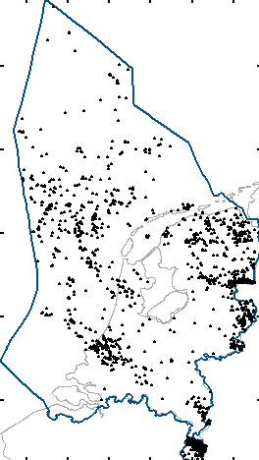
Comparison with VELMOD-3
Blind wells testing
TNO has performed a comparison of the residual thickness errors with a dataset of 3 017 blind wells for both VELMOD-3 and VELMOD-4b.
Standard deviation of the depth error (m)
Formation | VELMOD-3 | VELMOD-4b | Prediction improvement
NU | 27 | 25 | +7%
NLM | 36 | 25 | +30%
CK | 42 | 31 | +26%
KN | 32 | 27 | +16%
SAT | 28 | 23 | +18%
RNB | 38 | 36 | +5%
Blind wells

Slide 23
Deliverables

Slide 24
Deliverables
Seismic velocities
For each seismic velocity data set, 2D and 3D:
raw seismic velocity data file / standardized ASCII format
seismic velocity QC report
Regional velocity model
VELMOD-4a: 3D velocity model / 1km x 1km x 40ms
VELMOD-4b: V0, VINT for each geological layer (only VINT for the Zechstein fm) / 1km x 1km
depth converted surfaces / 250m x 250m
A specific grid mesh can be suggested
Report
VELMOD-4b full study report: description of data, models and parameters used for building the regional velocity model covering onshore and offshore Netherlands.

Slide 25
Appendix
VELMOD-4 formations

Slide 26
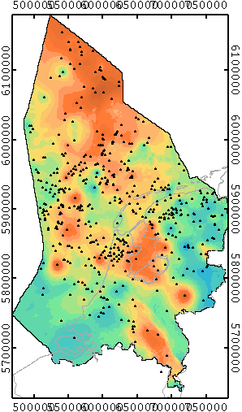
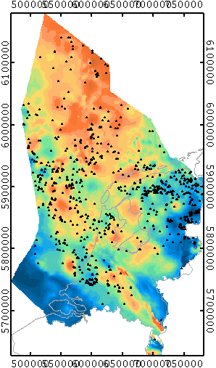
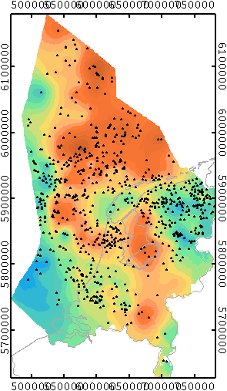

Upper North Sea Group
VINT ESTIMATION
VELMOD-3
VELMOD-4a
VELMOD-4b

Slide 27
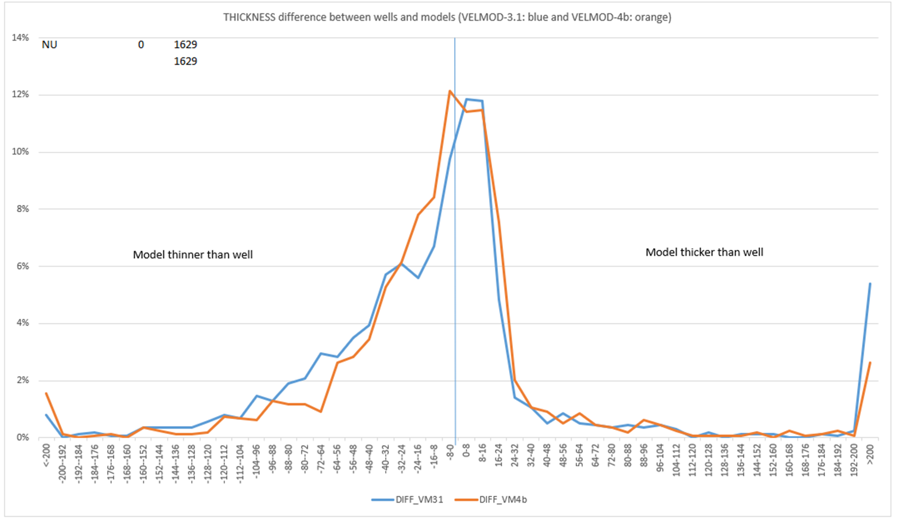
Comparison with VELMOD-3
NU (Upper North Sea Group)

Slide 28
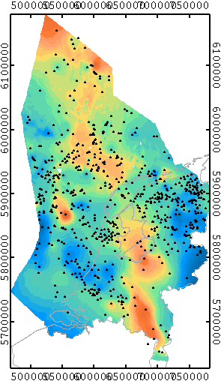
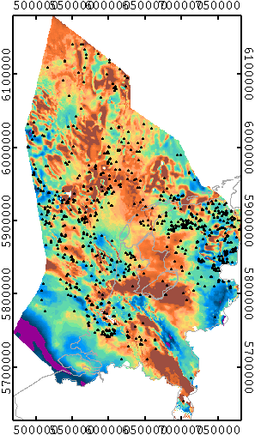
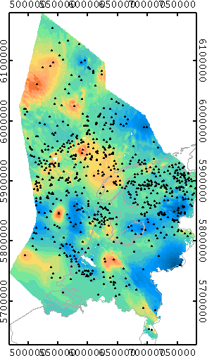

Middle & Lower North Sea Group
VINT ESTIMATION
VELMOD-3
VELMOD-4a
VELMOD-4b

Slide 29
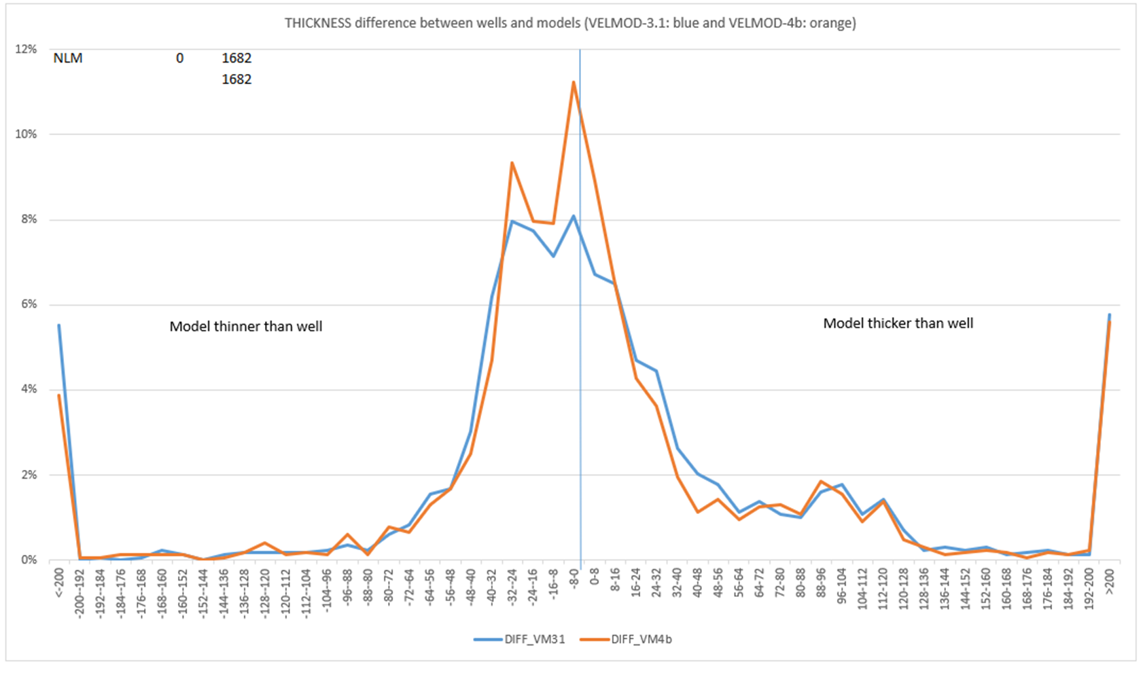
Comparison with VELMOD-3
NLM (Middle and Lower North Sea Group)

Slide 30
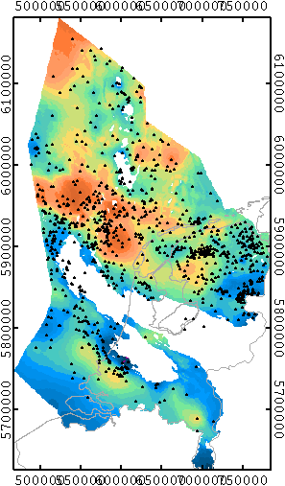
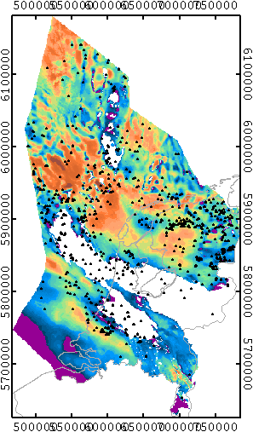
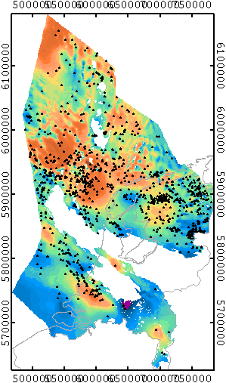

Chalk Group
VINT ESTIMATION
VELMOD-3
VELMOD-4a
VELMOD-4b

Slide 31
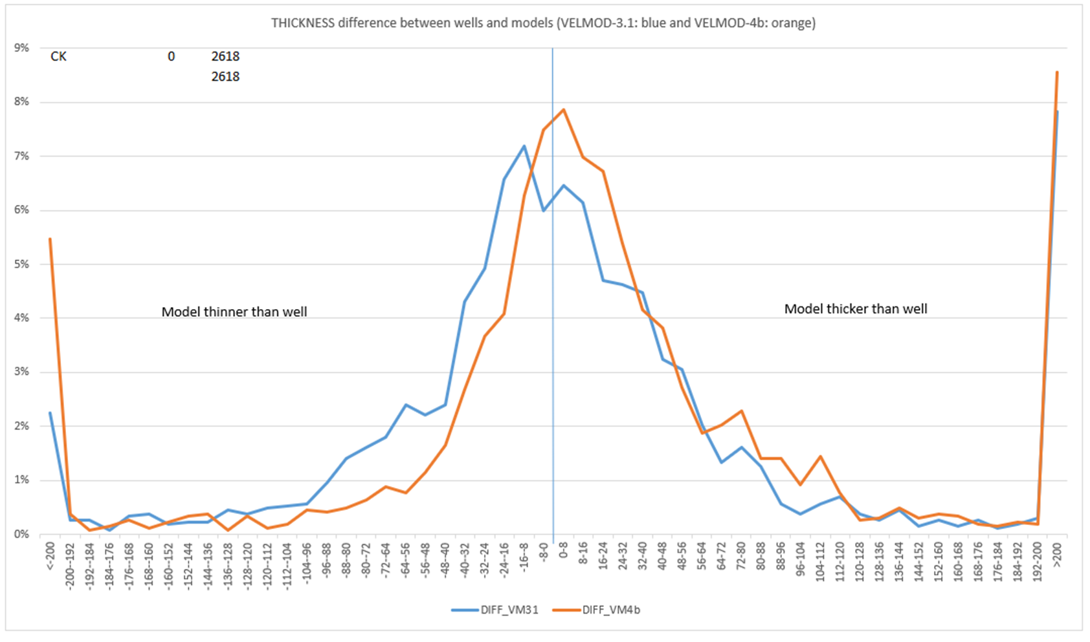
Comparison with VELMOD-3
CK (Chalk Group)

Slide 32
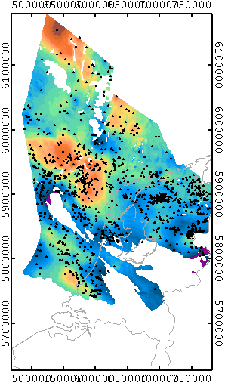
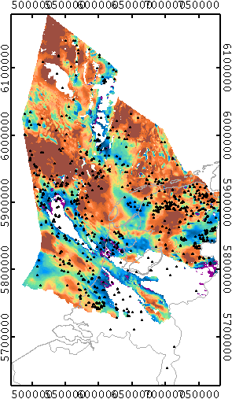
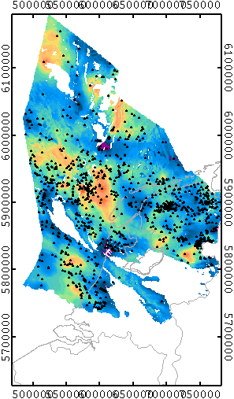

Rijnland Group
VINT ESTIMATION
VELMOD-3
VELMOD-4a
VELMOD-4b

Slide 33
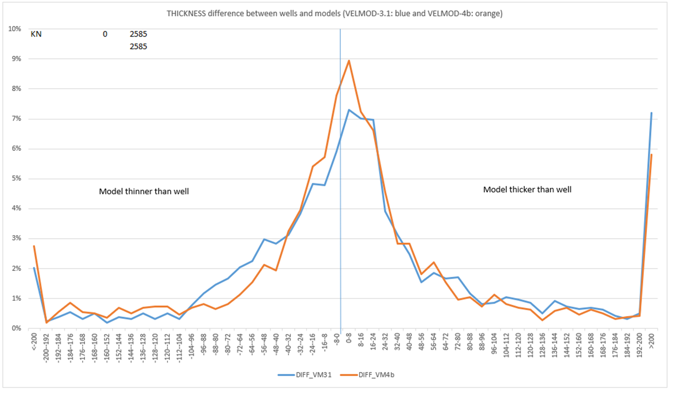
Comparison with VELMOD-3
KN (Rijnland Group)

Slide 34
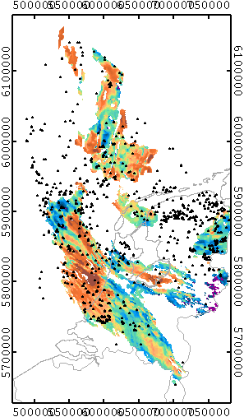
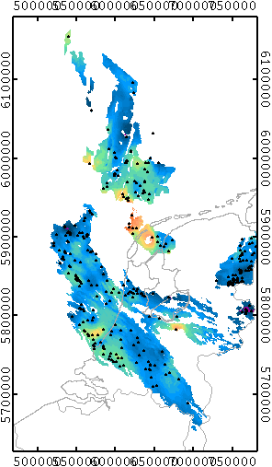

Schieland & Altena Group
VINT ESTIMATION
No map available
VELMOD-3
VELMOD-4a
VELMOD-4b

Slide 35
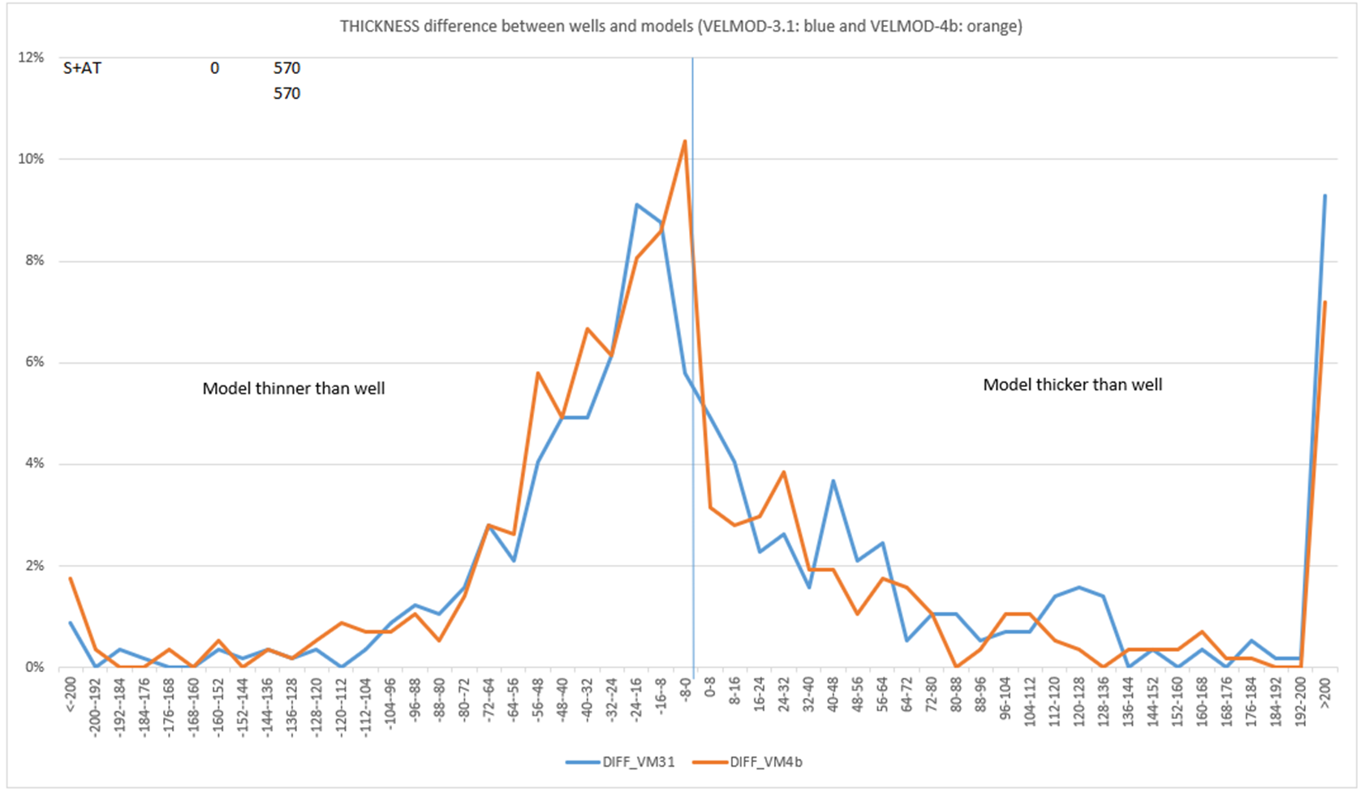
Comparison with VELMOD-3
S+AT (Schieland and Altena Group)

Slide 36
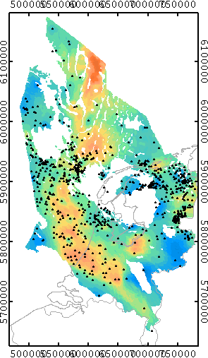
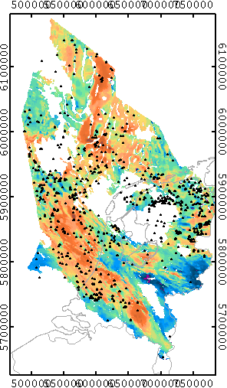
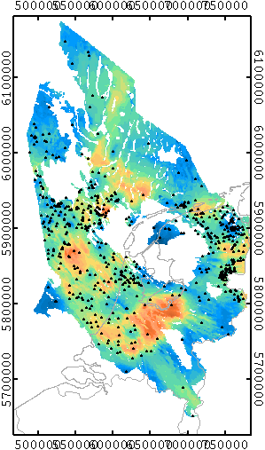

Trias Group
VINT ESTIMATION
VELMOD-3
VELMOD-4a
VELMOD-4b

Slide 37
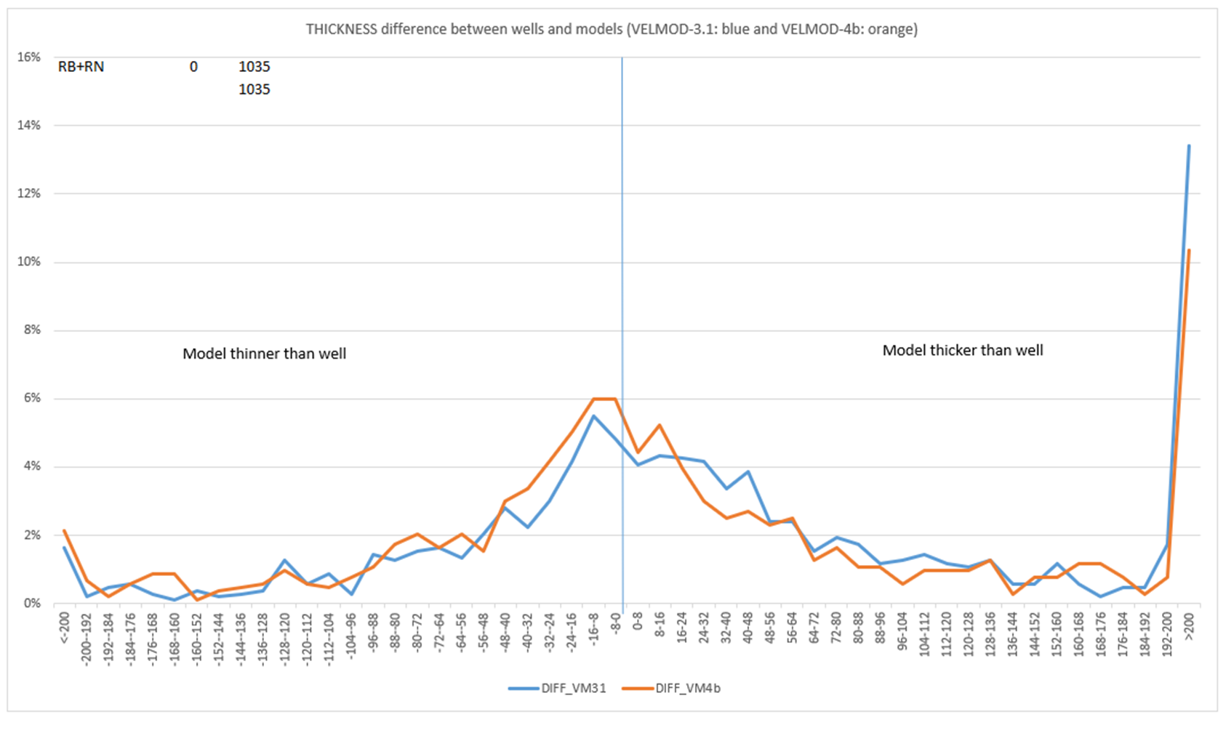
Comparison with VELMOD-3
RB+RN (Lower and Upper Germanic Trias Group)

Slide 38
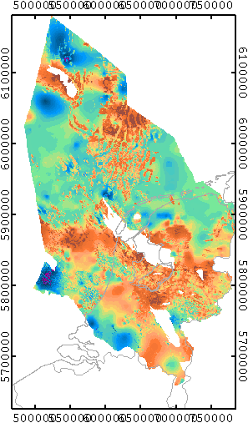
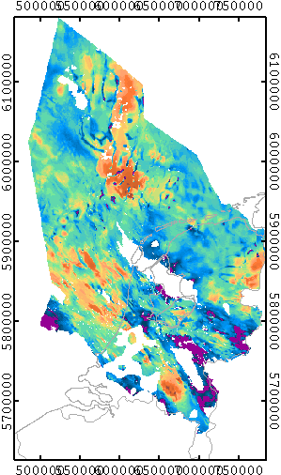
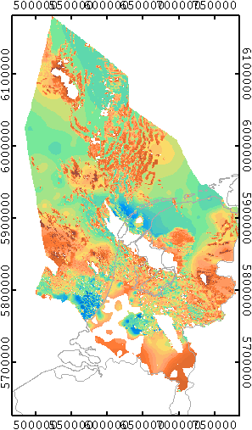

Zechstein Group
VINT ESTIMATION
VELMOD-3
VELMOD-4a
VELMOD-4b

